Slide 1
Mastering AI Coding Assistants With CoPilot
Updated June 2025
Gonen Israeli

Slide 2

A Few Words Before We Start
Seminar Introduction

Slide 3


A Little about the Instructor
Gonen Israeli – Software Engineering Consultant
First Student Job, at IBM 1990, Florida

Slide 4


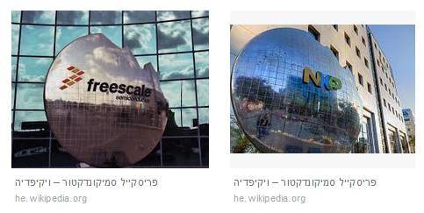


A Little about the Instructor
Gonen Israeli – Software Engineering Consultant
Worked and taught at Motorola, Amdocs, Checkpoint, Nova, Intel, Ebay, many others

Slide 5



What I Do
I share my time...
Instructor and Methodologies Consultant
Project Outsourcing
Agile, TDD, Quality Engineering, Java/C++/others

Slide 6


About me
Personal Stuff
I Live in Kfar Saba
Tae-Kwon-Do black belt
Harmonica fan

Slide 7

AI Lates News
Series of lates updates on hot topics in AI

Slide 8

March 2025 Vibe Coding
Vibe Coding Trend
Coined by Andrej Karpathy (OpenAI cofounder), February 2025​
Programmers describe problems; AI generates code​
Shifts role from manual coding to ideas, guiding and testing AI outputs​
Anthropic (Claude) CEO: AI to write 99% of code within 12 months​ (!)
Risks: security flaws, unstable apps, poor optimization​
Best Practices for Vibe Coding
Choose Simple, Popular Tech Stacks
React, Express, Tailwind, Redis, Deno, Vue.js, Nuxt
Master Version Control
AI may overwrite/delete working code
Use Git, auto-commit tools (e.g., Claude Code)
Effective AI Prompting
Break problems into small, clear steps
Provide context (docs, UI images) for better results
AI as a Developer's Tool, Not a Replacement
Currently needs human oversight​, good for small projects
Future: AI-led, human-managed coding for scalability & reliability

Slide 9
March 2025 – New Releases
Google's Gemini 2.5 Pro
Quietly outperforms OpenAI models
Free alternative to OpenAI Pro ($200/mo)
Strong in programming & reasoning
OpenAI’s GPT-40 Image Generator
Transforms images into specific art styles
Near-perfect text rendering for infographics
Maintains character continuity in AI-generated avatars
Uses autoregressive (pixel-by-pixel) vs. diffusion models
Watermarked by C2PA for tracking modifications
AI & Content Moderation
YouTube/Steam requiring AI disclosure
Debate over whether AI content should be labeled
C2PA seen as “deep-state bloatware” vs. protection from misinformation

Slide 10
March 2025 – Chinese Uprising
China’s AI Surge
DeepSeek 3.1 – Competitive performance
Alibaba’s Qwen 2.5 Omni – Multimodal AI
New “Thinker Talker” architecture
Capable of real time voice and video chat
Tencent T1 – Competing with DeepSeek
Demo on huggingface produced a lot of garbage
ByteDance’s Dapo – Open-source RL for LLMs

Slide 11
March 2025 – MCP
Model Context Protocol (MCP) is the Future of APIs ?
A new standard for building AI-powered applications
Adopted into OpenAI Agents SDK & designed by Anthropic
Enables LLMs to execute code and fetch data dynamically
RAG in the Cloud
Query the LLM about data that you have on the cloud
Automated AI Development
Developers are using MCP to integrate LLMs into workflows
AI (Claude Desktop) can now execute commands, query databases, upload files, etc
Early adopters are automating trading, web scraping, cloud mgmt
Some fear AI will eventually write AND execute code autonomously
AI-Driven Development: The End of Traditional Coding?
User will type into LLM what changes to make in the cloud
AI can change resources and code

Slide 12

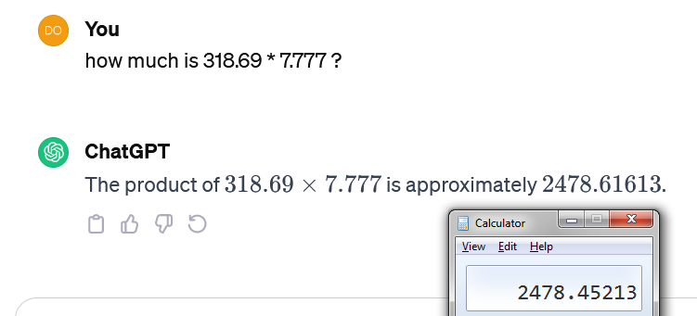
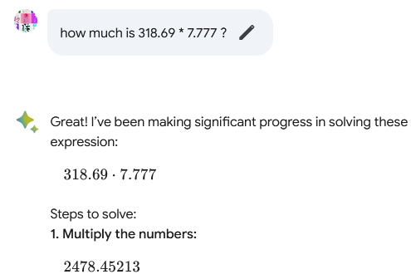
Relying on AI
Here are some good ideas...
Always double check the AI's result!
Compare to web search
Compare to other AI
Check the work yourself
Always use the latest available version
Be prepared for new vulnerabilities like prompt injection
Don't ask chatbots to do math
Don't ask chatbots to do indexing
or anything procedural code can do

Slide 13

What’s This Seminar?
FOCUS?
Where do we put the
This Seminar is about
How to leverage AI software development tools?
Prompt engineering?

Slide 14

Lecture Outline
Today’s Main Sections:
A few words before we start
Introduction to AI, Terminology
Code Assistant Tools (+Demos)
Prompt Engineering
AI For Software Development
AI and Software Architecture

Slide 15
Github Copilot
Introduction and A Bit Of History

Slide 16

Git
Distributed Version Control System
Designed for Parallel Branches on Different Computers
Free Open Source Software
Main Source Control For 95% of Developers
Created By Linus Torvalds for Work On Linux Kernel
Developed in 2005 after BitKeeper revoked his license

Slide 17

Github
Developer platform to create, store, manage, and share code
Uses Git For Source Control
Started in 2008 by 3 developers with Ruby On Rails
Microsoft Owned Since 2018
In 2023 World’s Largest Source Host: 100M Developers, 420M Repositories
Github Inc, Headquatered in California
Uses Git For Source Control Github Inc, Headquatered in California

Slide 18

Github Copilot
Code completion and automatic coding assistant
Developed by Github and OpenAI
Released as JetBrains plugin October 2021
Chat GPT (3.5) was only released November 2022
Evolution of Bing Code Search Plugin (2013)
Originally OpenAI, now lets users choose LLM

Slide 19
Github Copilot – Main Features
Code auto completion – suggest code as you type ( accept with tab )
Prompt based code generation – Chat panel to generate, explain and refactor code
Context awareness – understands and uses local files and surrounding code
IDE integration – keyboard shortcuts, file aware chat, run commands, inline previews
Interactive : comments to code, auto complete
Multi language support ( C#, C++, Python, Java… )

Slide 20
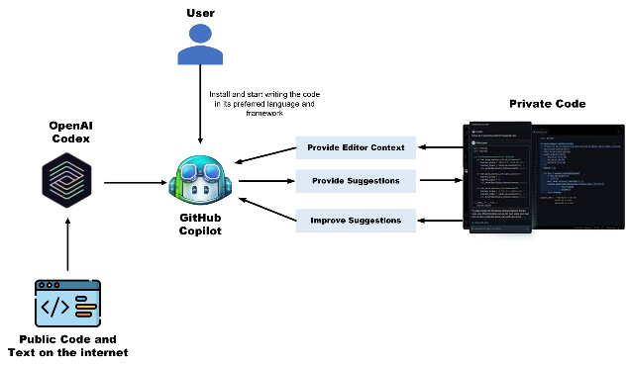
CoPilot – How does it work?
Basically it just sends your chat and existing code to an AI
Context Awareness:
Prompt Construction:
LLM Processing:
Response Integration:
Image source https://rajanieshkaushikk.com/2023/07/18/supercharge-your-coding-with-github-copilot-the-future-of-intelligent-autocompletion/

Slide 21
CoPilot – How does it work?
Context Awareness:
CoPilot analyzes your current file, selection, and surrounding code to understand what you're working on.
Prompt Construction:
It sends a combination of your code, comments, and chat input to an LLM, such as ChatGPT.
2 completely separate mechanisms: Code completion and Chat
LLM Processing:
The model interprets the context and generates suggestions—explanations, code completions, fixes, docs
Response Integration:
The results are shown directly in your editor or chat, and you can accept, modify, or ignore them.
Code completions are inserted at the cursor
For changes, simple text diff advanced semantic diff is may applied to result vs. existing editor code to produce changes
Bigger changes rewrite entire file
Some responses are analyzed and sent to vs.code api, such as new file creation, tool running etc.
All Local? Not Quite:
Your code is securely sent to OpenAI (or another provider), processed there, and returned.
Image source https://rajanieshkaushikk.com/2023/07/18/supercharge-your-coding-with-github-copilot-the-future-of-intelligent-autocompletion/

Slide 22
Chat Memory
To work with AI effectively, you must understand context.
LLMs do not have conversation memory
To achieve memory, or context
Entire conversation is resent each time + new prompt
Memory is limited by input length (CoPilot 4K – 8K )
Request
Request
My name is Gonen.
ChatGPT
Stateless
No Context
My name is Gonen.
ChatGPT
Stateless
No
Context
Response
Response
Nice to meet you Gonen.
Nice to meet you Gonen.
Request
Request
What’s my name?
My name is Gonen.
Nice to meet you Gonen.
What’s my name?
Sorry. I don’t know.
Response
You told me that your
Name Is Gonen.
Response
Simulating chat memory

Slide 23
Demo: Creating A Chatbot
Each API call is stateless
Does not remember previous conversations
We can create a chatbot by resending entire conversation so far
conversation = ""
os.chdir('./openaiexamples')
while True:
# Get user input
user_input = input(">")
conversation = conversation + user_input + "\n"
# Check if user wants to exit
if user_input == 'exit':
break
# Call the helper function
response = send_message(client, conversation)
# Get response from AI
actualResponse = response.choices[0].message.content
print(actualResponse)
conversation = conversation + actualResponse + "\n"

Slide 24
Essential Keyboard Shortcuts
CTRL + I Open In Editor AI Prompt
Tab Accept auto completion suggestion
Esc Reject and clear auto completion
ALT + ] Next auto complete suggestion
Ctrl + ALT + I Open and go to Chat Window

Slide 25
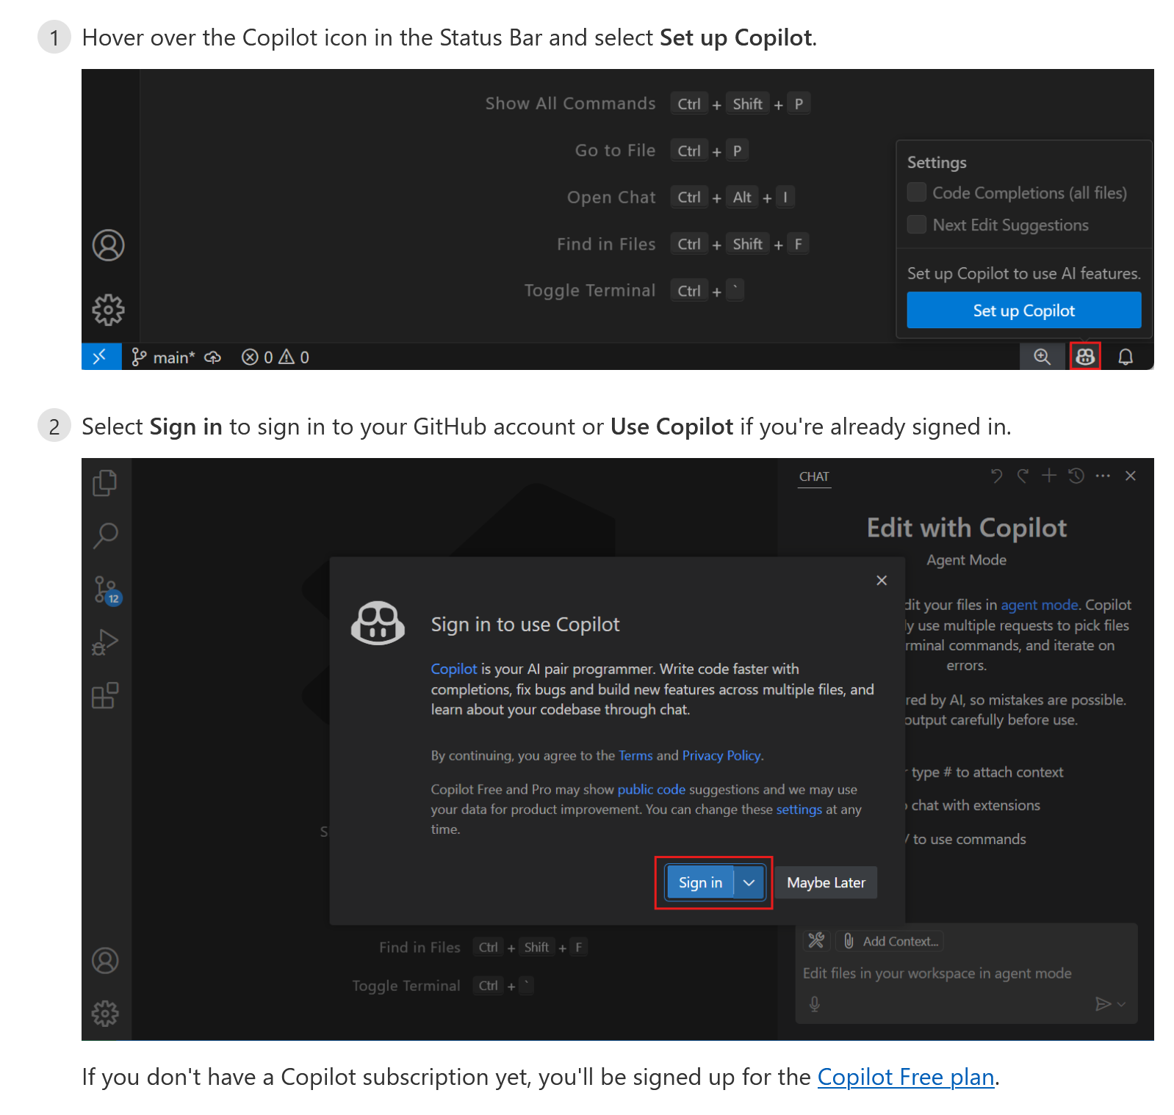
Set Up Copilot In Visual Studio
https://code.visualstudio.com/docs/copilot/setup

Slide 26
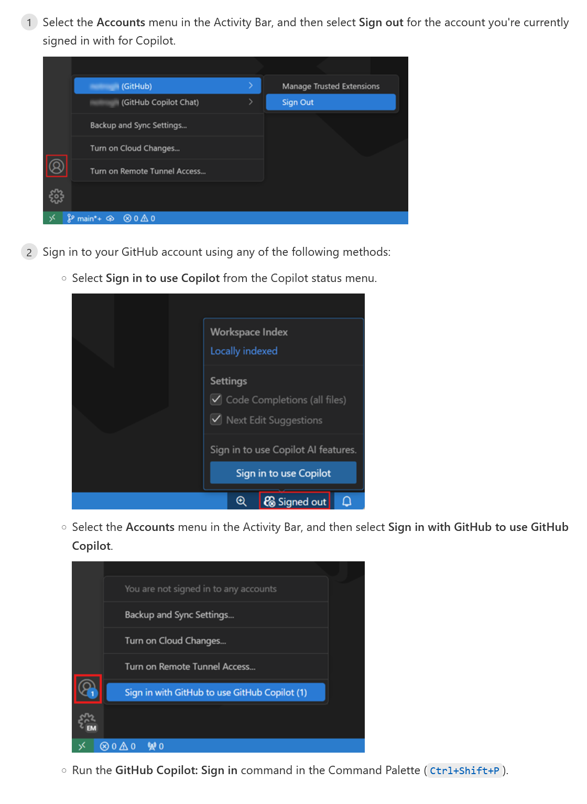
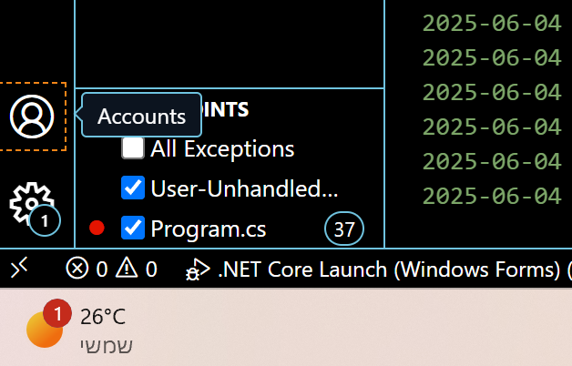
Github Account Setup
Select accounts on lower left of VS code
Choose Github
Sign in or out
You may have to sign into github on a browser window

Slide 27
CoPilot Free
GitHub Copilot Free
Includes up to 2,000 code completions in IDEs per month
Includes up to 50 total chat requests per month in Copilot Chat
Designed to give you a limited taste of Copilot's capabilities
No subscription or payment required
Intended for personal use only, not for users managed by an organization or enterprise

Slide 28
Copilot Don’ts (What Not To Do)
Don’t ask it to write the entire application
Don’t let it lead
Don’t submit without review
Don’t use the wrong tool. To add one line prefer
Speed: completions, in editor-chat, chat window, agent
In editor chat -> ghost text -> comment -> chat wind
Don’t forget about /fix /explain /tests
Don’t forget about context
Erase old parts of question, highlight discussed code
Use up down arrows in chat, @workspace, file ctxt

Slide 29
Basic Features
Getting Started With CoPilot

Slide 30
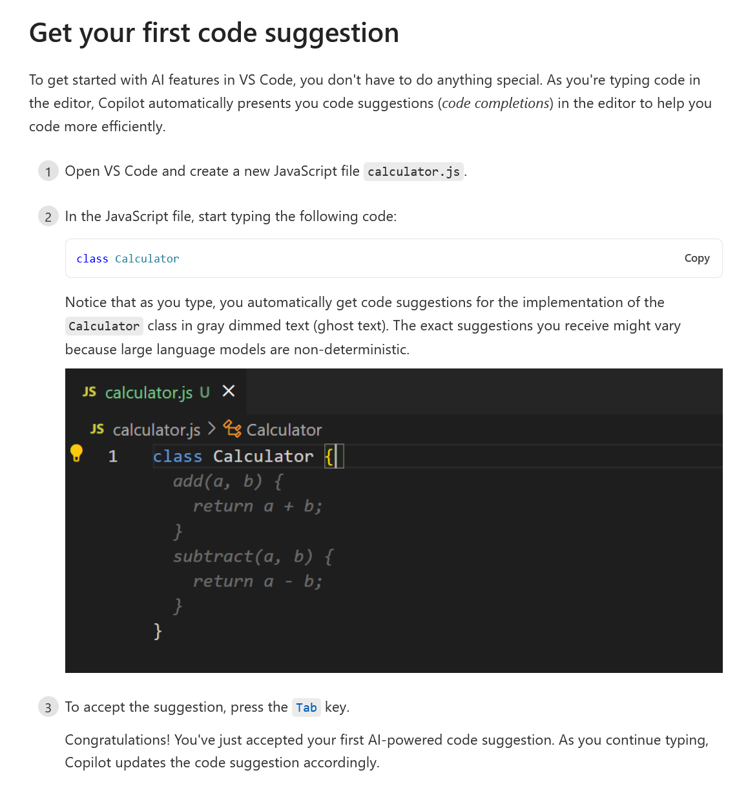
Getting Code Suggestions
Just begin to type code
Suggestions shown as ghost text as you type
Completion model can be changed independently of chat (GPT 4 by default )

Slide 31
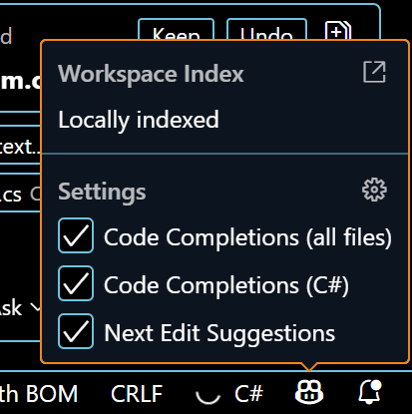
Disabling Suggestions
You can quickly enable and disable code completion
Click the CoPilot Icon on the lower right

Slide 32
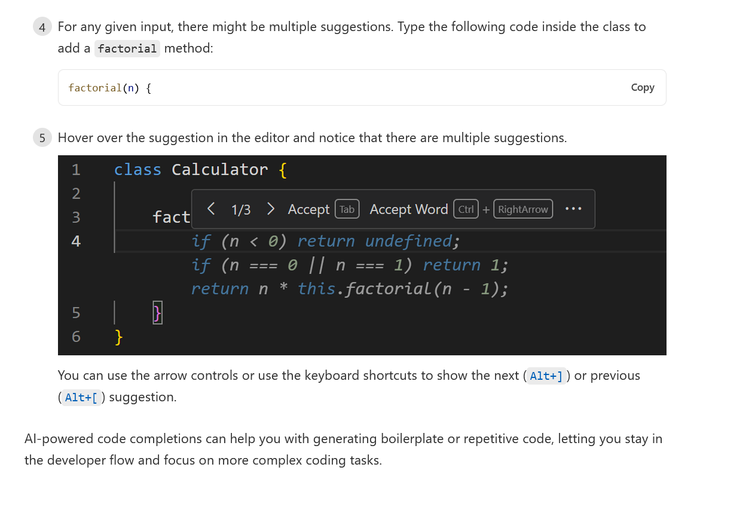
Cycling Through Suggestions
Tab to accept
Esc or keep typing to ignore
Ctrl+Right to accept just next word
Ctrl+] for next suggestion

Slide 33
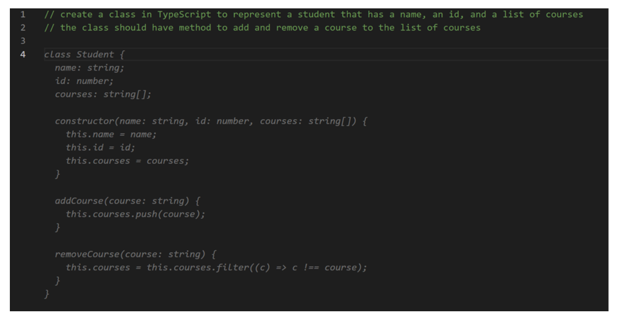
Generating Code Using Comments
We can use code suggestions for code creation
Just add a comment for what you want to create
Press enter and Copilot will complete it
Don’t overuse this – sometimes it may be better to use inline chat or the chat window
Comments need to stay updated or deleted if code changes

Slide 34
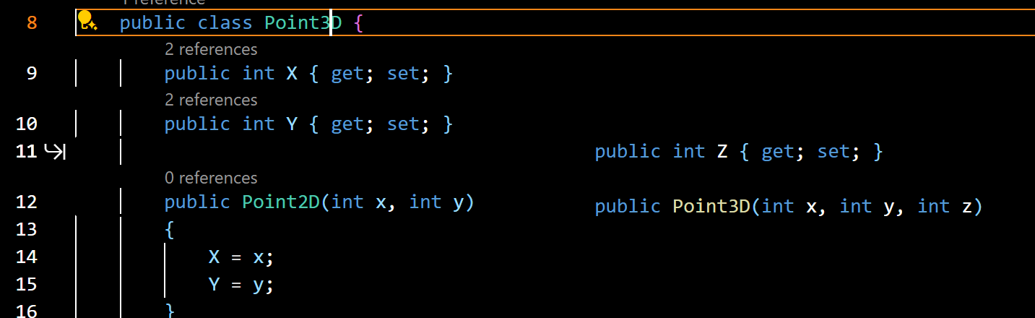
Next Edit Suggestion (NES)
Optional Setting – can be a bit distracting – enable from Copilot icon
Allows copilot to suggest other edits when you edit code
Examples:
Change class Point2D to 3D
CoPilot will suggest modifying constructor, setters, ToString
Fix common mistakes as you type, suggest changing names for conventions
Same as code suggestions, but for modifying existing code
Change may be required in several places
Arrow shows the next change that is suggested
Tab accepts current change and moves you to the next one

Slide 35
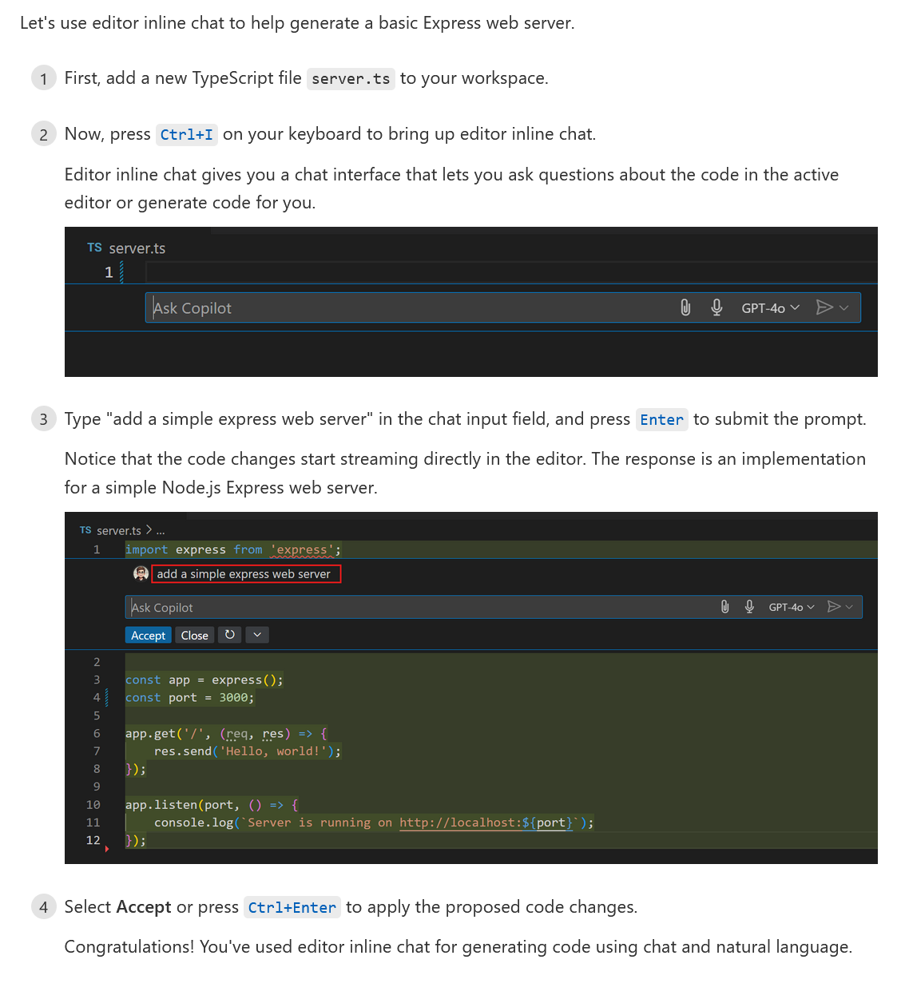
Using Editor Inline Chat

Slide 36
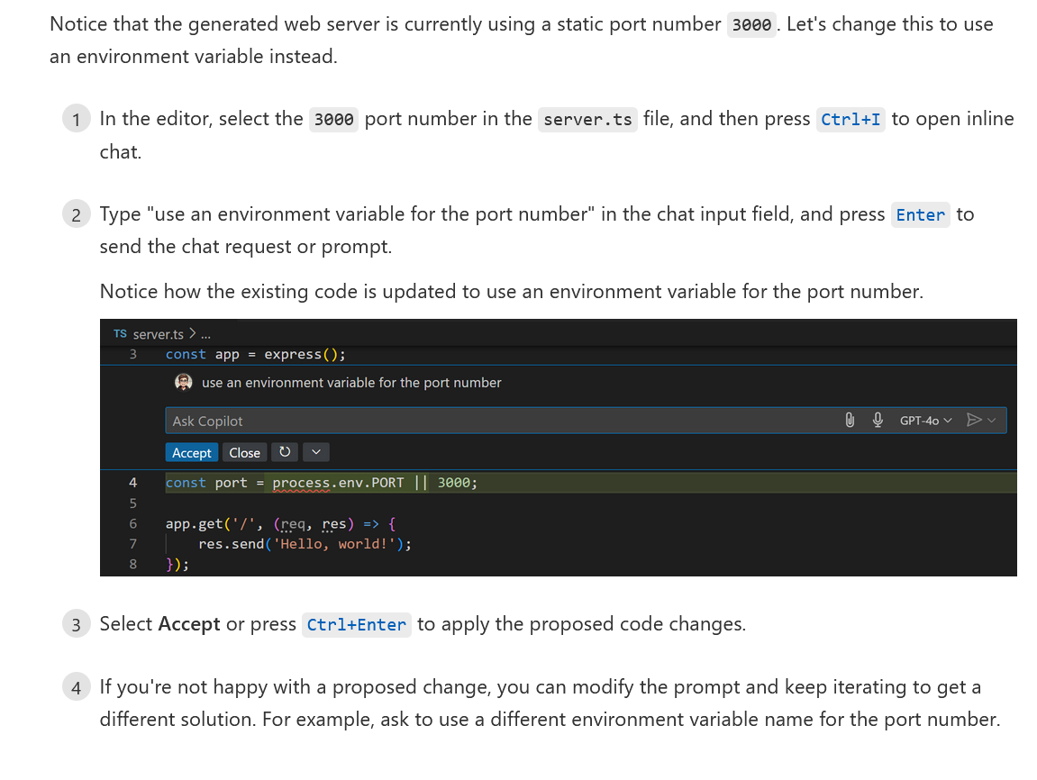
Refactor With Inline Chat

Slide 37
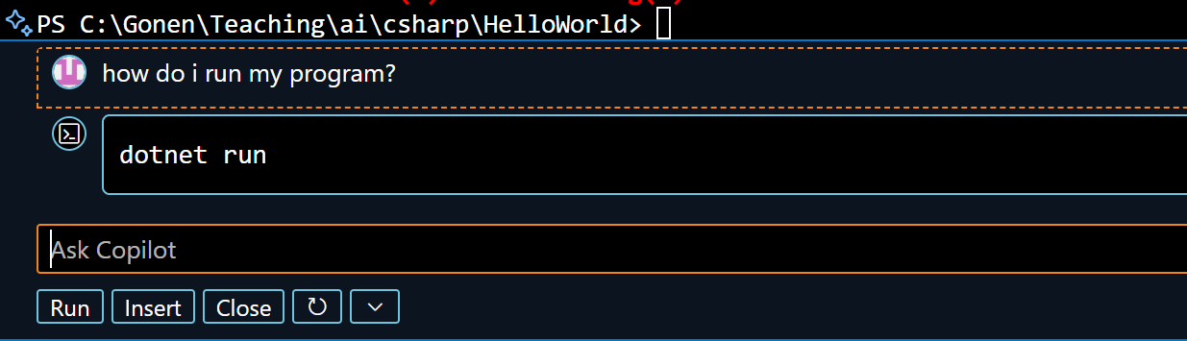
Terminal Inline Chat
Yes, really!
Press Ctrl+I in the terminal to get some help
Useful for things like how-to-install
Does not see terminal output without explicit copying
So, not very useful

Slide 38
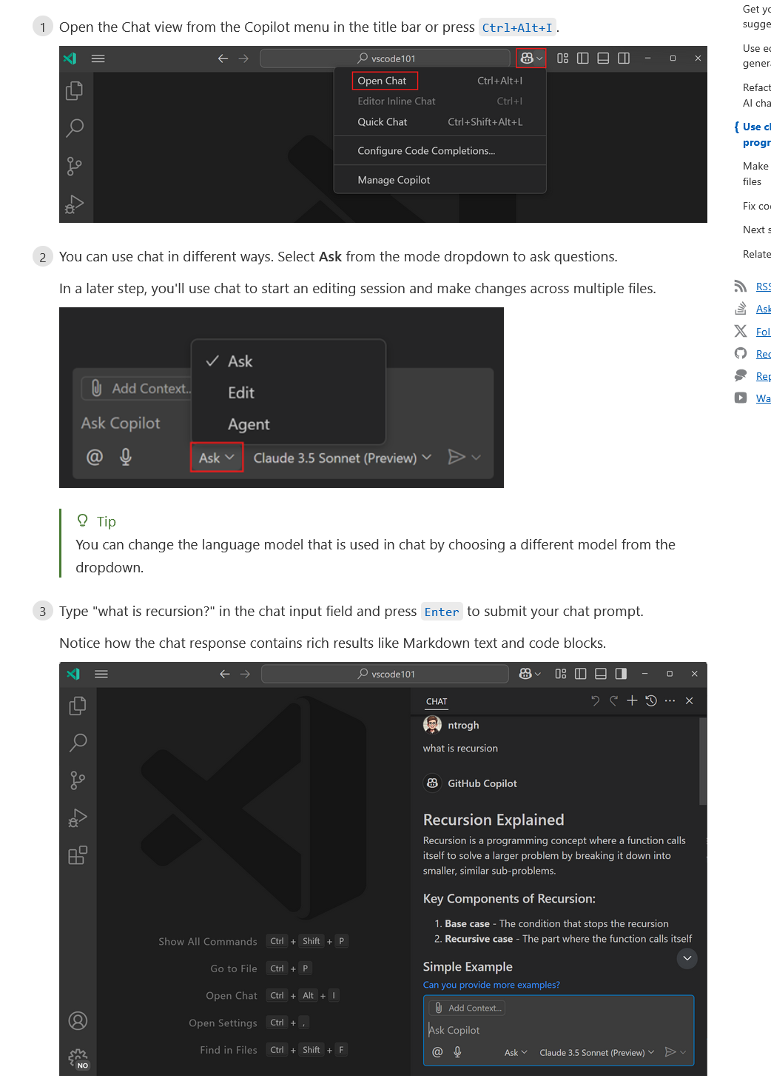
Use Chat Window
For general questions
To make complex code changes
Modes available
Ask
Edit
Agent
Choose your chat model (LLM)

Slide 39
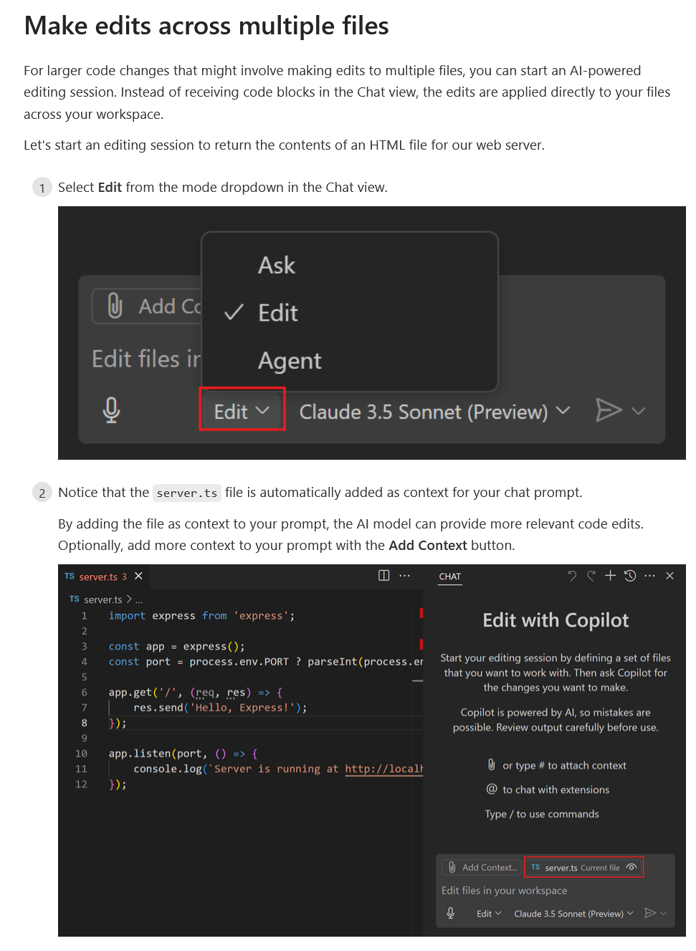
Multiple File and Large Changes
Open Chat with Ctrl-Alt-I
Work in Edit or Agent mode
Add necessary files to context

Slide 40
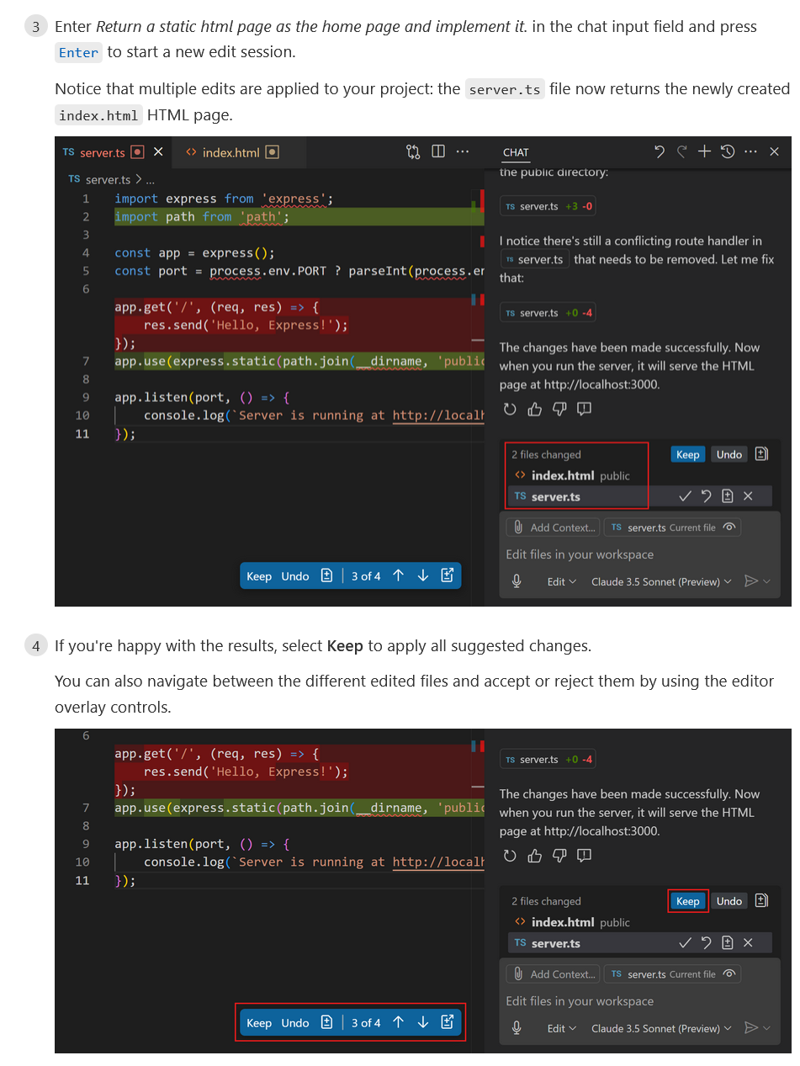
Multiple File Edits
Changes are seen in color coding
Red = removed
Green = added
Press Keep or Undo

Slide 41
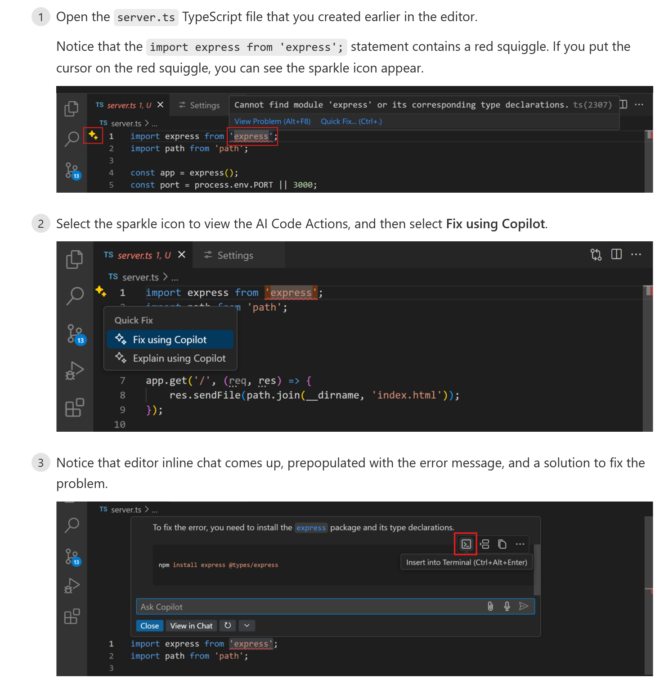
Fixing Errors
You can request error fix using AI several ways
choose from context menu
from inline chat
from chat window
AI may suggest code or tool fixes
You can select apply from chat

Slide 42
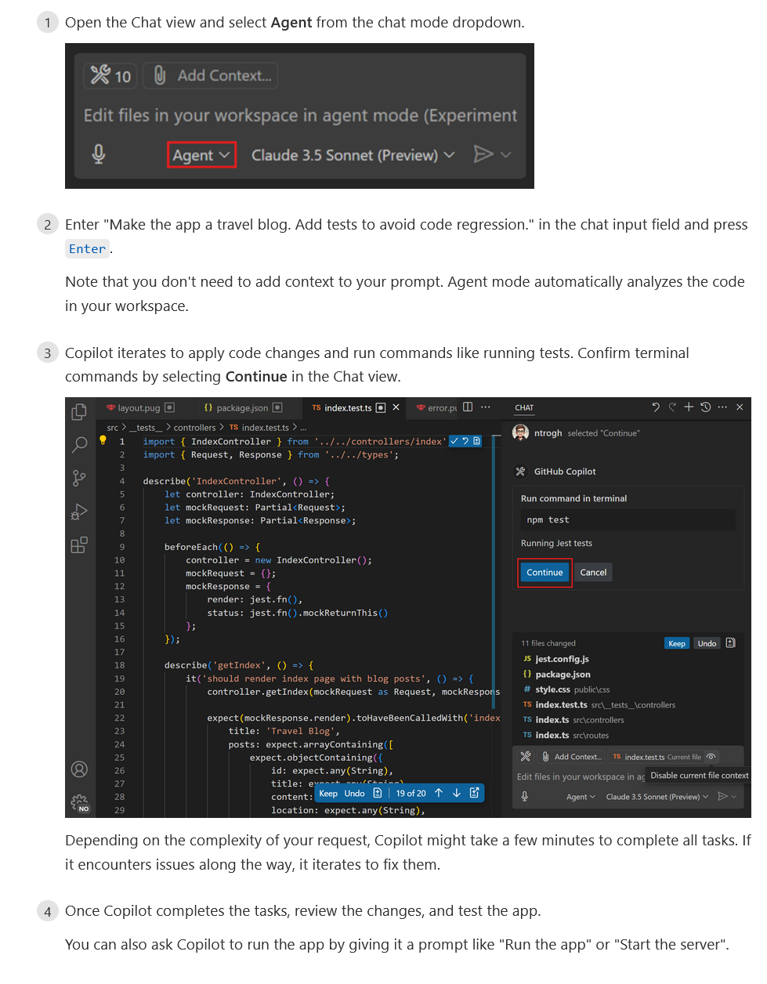
Working With Agent Mode
For longer, more complex tasks
Copilot plans several tasks, then executes them one by one
Can involve code in multiple files
Can involve terminal commands for several tools
Sometimes Agent mode needs to be enabled in settings
Agent Vs. Edit
Edit mode: Only in-file changes
Edit mode is faster
Edit mode is more deterministic
Agent mode is a better planner, designer, more capable
Agent mode can run commands, add files, iterate changes

Slide 43
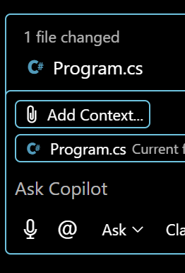
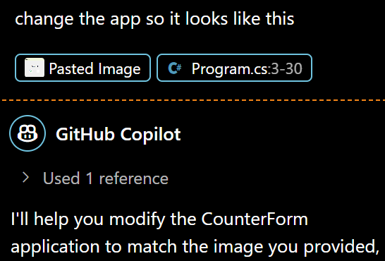
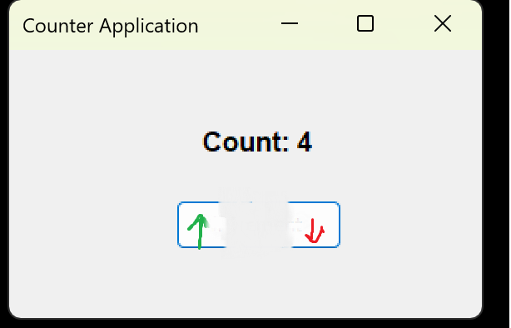
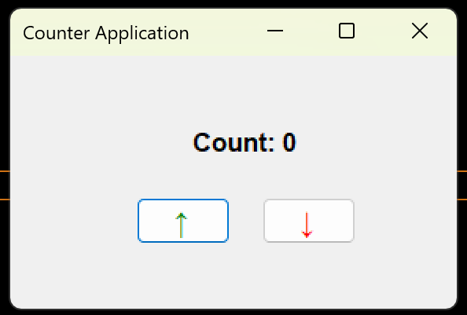
Using Vision and Speech
You can use vision in chat
Create UI from an example
Explain a code snapshot
Ask about UI errors
Attach a file or paste copied image from clipboard
Use speech in chat
Press the microphone icon
Talk to tell copilot what to do
Requires extension

Slide 44
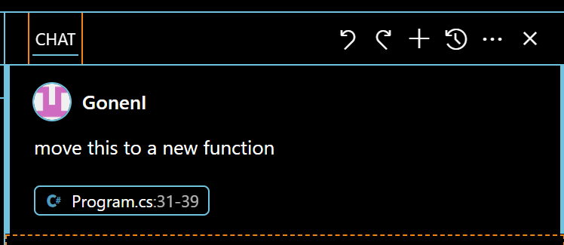
Important Chat Tools
Undo-Redo for undoing your latest AI changes
Icon ‘+’ to start a new chat , important when AI gets confused by previous questions
Chat History – Go back to previous chat sessions, like with ChatGPT
Open chat in editor or new window ( on the … )

Slide 45
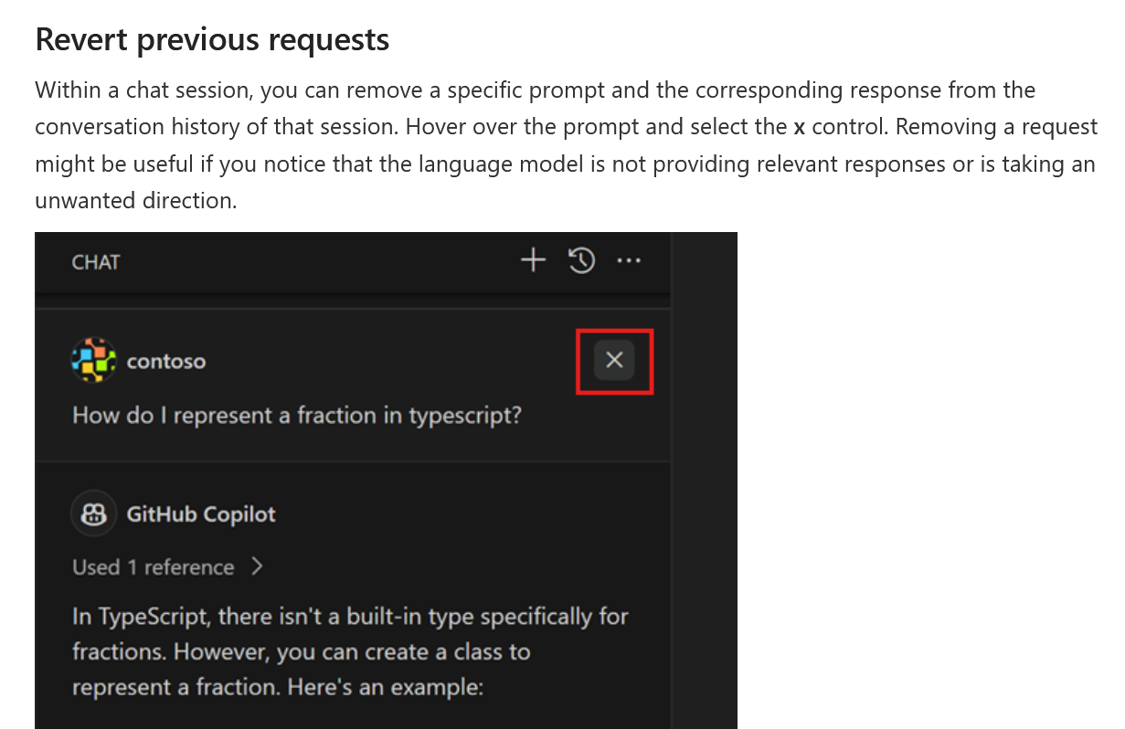
Delete Parts of Chat
Instead of clearing entire chat, you can delete a part
You can remove parts that might be confusing
Can also reduce prompt load
Deleting a question also deletes the response

Slide 46
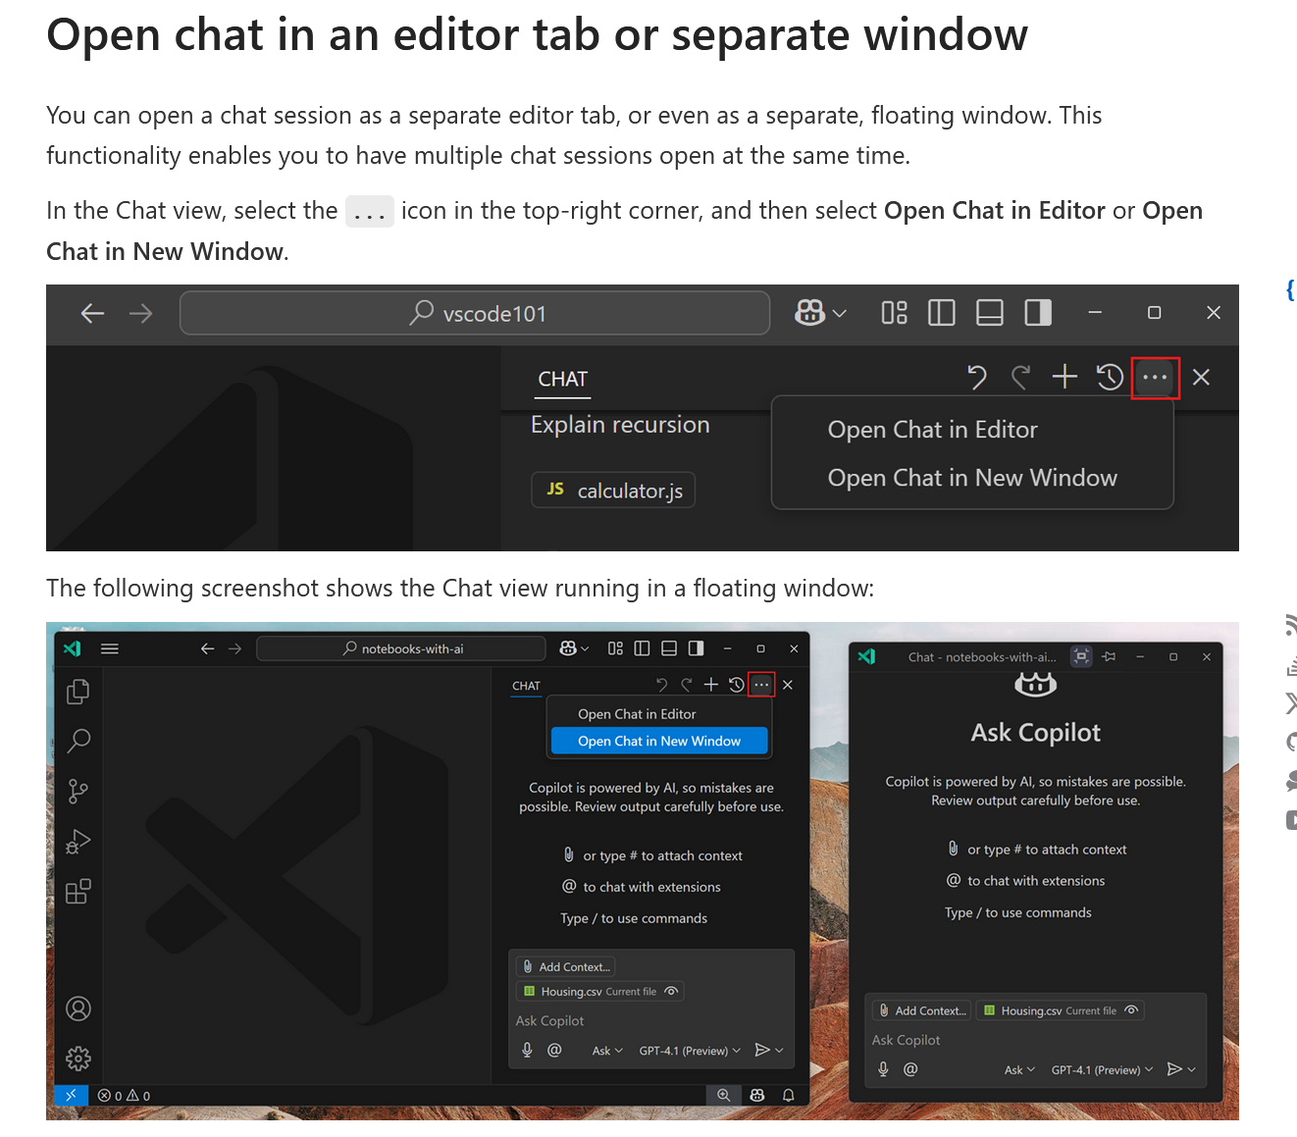
Multiple Chat Windows
Chat can be in a tab or it’s own floating window

Slide 47
Chat Effectively With Chat Commands
Command | Description
/explain | Explains the selected code or the code context around your cursor
/fix | Attempts to fix problems in the selected code
/tests | Generates tests for the selected code
/doc | Adds or improves documentation for the selected code
/generate | Generates code based on your prompt or context
/help | Lists available slash commands
/clear | Clears the current chat thread
/save | Save the chat to a prompt file

Slide 48
Focus Topic With @-Mentions
Specify what question is related to
Usually not required — Copilot infers context automatically
Used To:
Speed up responses ( AI searches through less )
Improve precision in large or multi-language projects
Trigger tool-specific help
Examples
@vscode How do I create a new file?
@terminal What's the command to start the server?
@python Why am I getting a TypeError?
@git How do I undo the last commit?
@tests Generate a unit test for this function
Hard to see any real benefit over same sentence without @

Slide 49
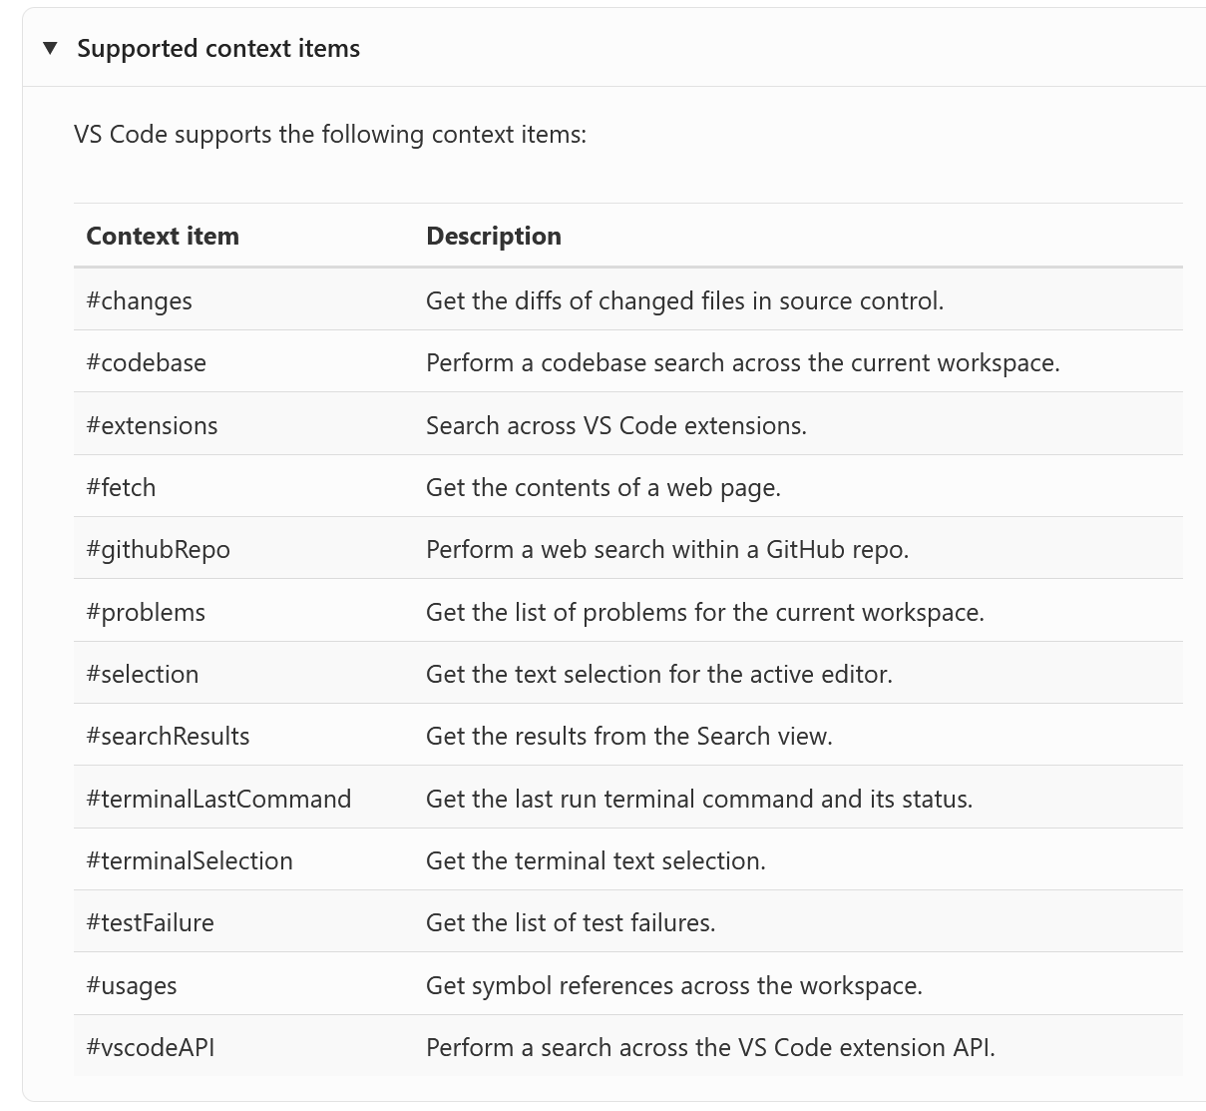
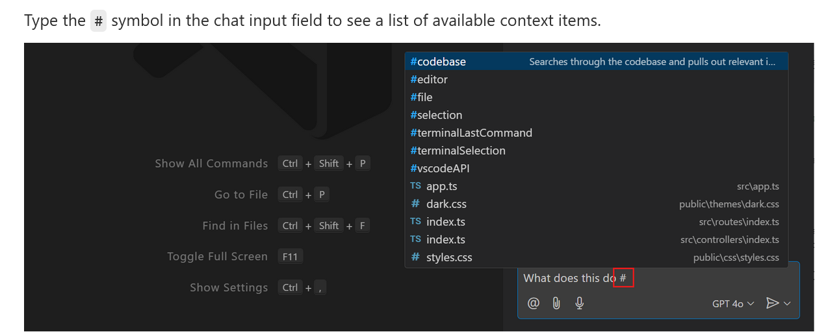
Bring Text with #-Mentions
Specifies what text to add to the question
Examples:
What does the error in #problems mean
What’s the license of #fetch Mockito.com
Break #program.cs into more functions
Often unnecessary as the AI chat understands without it, especially in Agent mode which takes context automatically.
Hard to see any real benefit over same sentence without #

Slide 50
Smart Actions and Code Quality Tools
Code development assistance beyond just writing code.

Slide 51
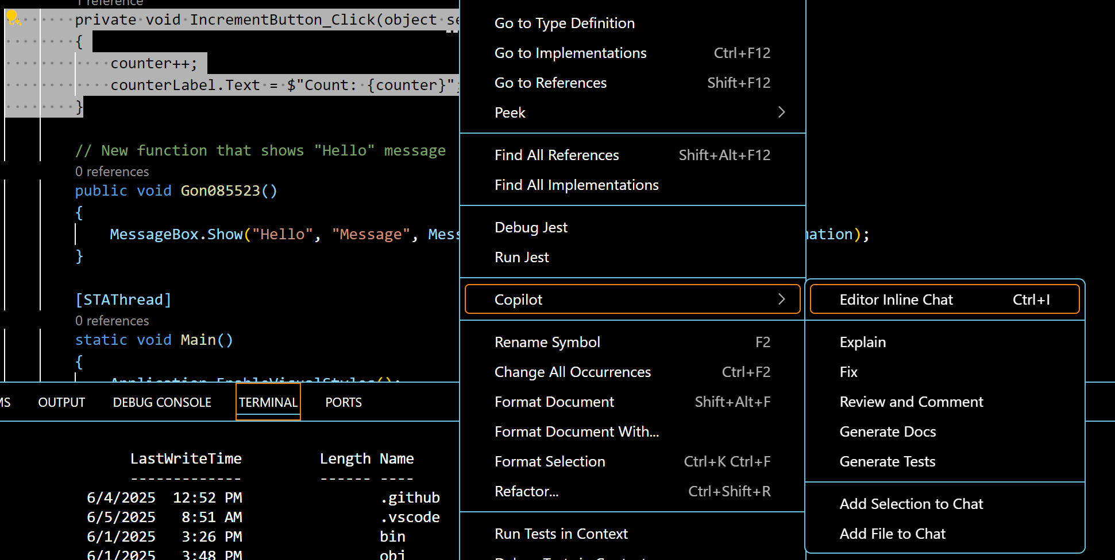
Smart Actions
CoPilot can provide help beyond just code writing
Highlight some code, right click then choose copilot
CoPilot can
Explain the code
Try to fix bugs in the code
Review your code
Generate docs
Generate Tests

Slide 52
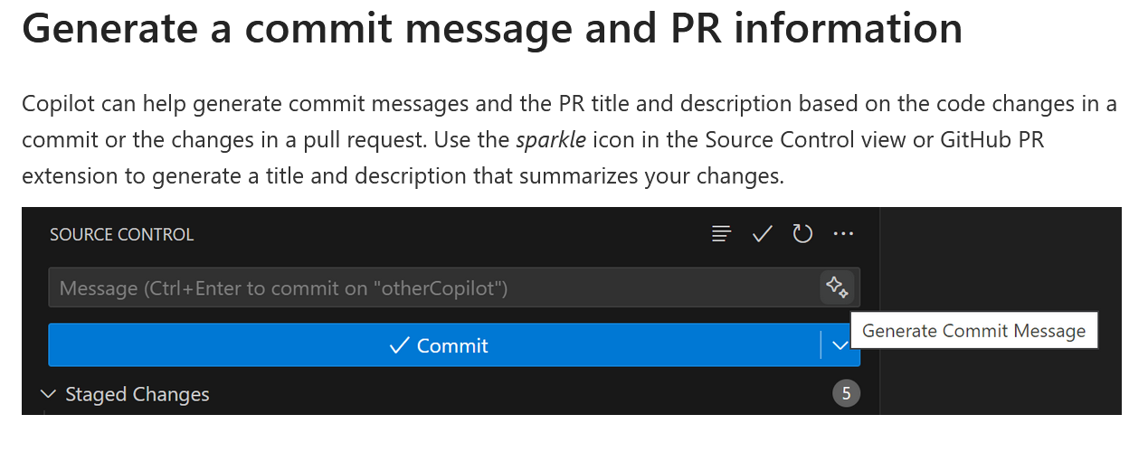
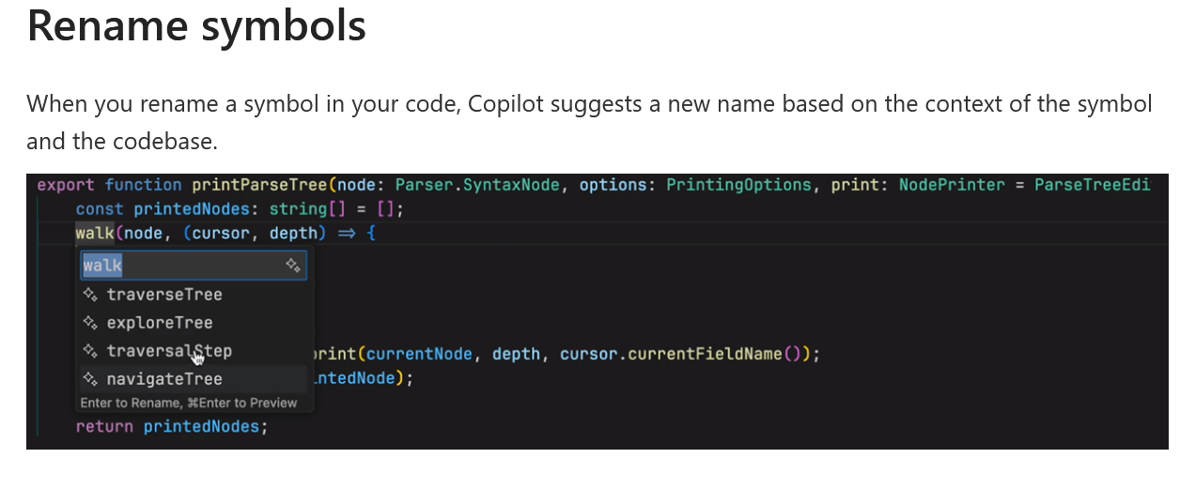
Smart Commits and Names
CoPilot can provide help beyond just code writing
Generating commit messages
Suggesting symbol names

Slide 53
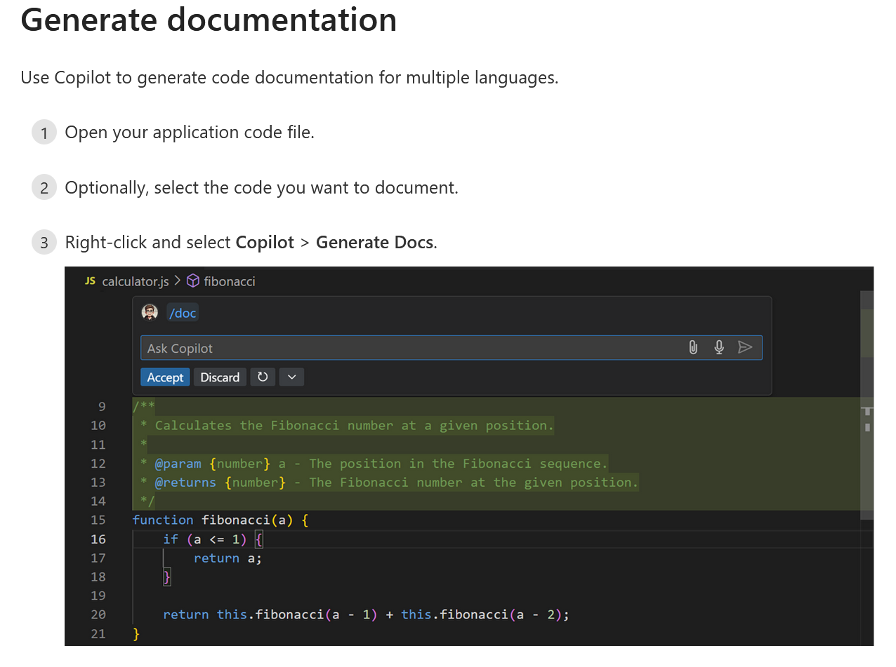
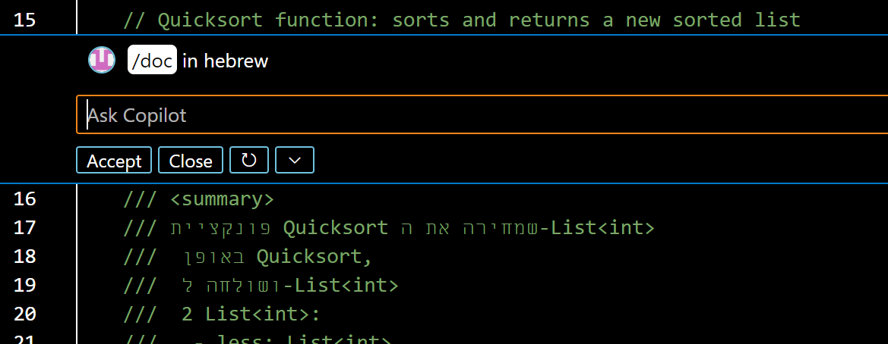
Generate Documentation
Use CoPilot for Automatic code documentation generation
From inline chat or chat window type /doc
You can add custom instructions after /doc

Slide 54
Tests and Code Review
CoPilot can create tests from menu or chat
"Write unit tests including edge cases"
"Create integration tests for this module“
Or, Select code, then Right-click and select Copilot > Generate Tests.
Use custom instructions to personalize test frameworks, conventions
CoPilot can try to fix the code for failing tests
In the Test Explorer, hover over a failing test
Select the Fix Test Failure button (sparkle icon)
Or in chat, “/fixTestFailure”
CoPilot can review your code for problems
From Chat
Right click a code segment then CoPilot->Review

Slide 55
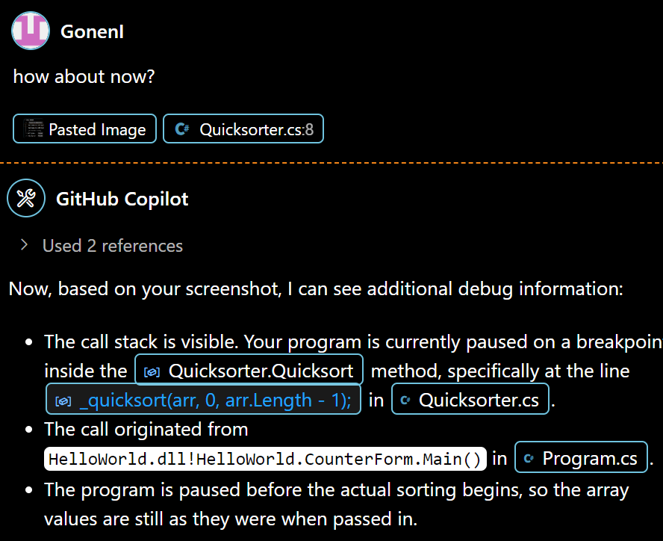
Debugging With CoPilot
In chat, enter #startDebugging
Currently limited (6-2025)
Can See
Current line
Overall file structure
Cannot See
Breakpoints
Current variable values ( can guess them )
Call stack
However, you can give the AI info with screenshots

Slide 56
Working Effectively With CoPilot
Tips and Tricks

Slide 57
Prompt Engineering For VS Code CoPilot
Provide the right context
Keep related files open. Close others.
Prime CoPilot with Sample Code
“Lay out my class like this example here:”
Use 3S Principle: Simple, Specific, Short

Slide 58
Using The 3S Principle
Simple:
Break large tasks into smaller simple ones
For example, instead of saying “Design My App”, first ask AI to create Server then Client
Specific:
On large new request add specifics like language, file to put code in, Design pattern or API you want
For example “In controller.cs create a controller function for the shopping cart that will accept Icart interface by dependency injection”
Use context like #selection @workspace. This is becoming less relevant with Agent
Short:
Be less verbose than when talking to people.
For example “Add shopping cart to cached class list”

Slide 59
Clean Code For AI Prompting
Use top level comments
A top level comment in the file can explain the purpose of the file, just like for humans
It can also remind the AI what we’re trying to do here on long tasks.
Comments need to be updated or deleted if code changes
Write the appropriate includes yourself
For example, If you don’t include your logger, AI will try to use Console.log
Use meaningful names ( functions, class, variables)
Add “why” comments on difficult to understand concepts in functions
Be consistently clean
Garbage in -> Garbage out
If you start hacking, even if temporarily, the AI may emulate your style

Slide 60
Checklist for Mastering CoPilot
Choose the right tool. Use the tool that's optimized for editing, asking questions, long flows
Personalize Copilot. Use custom instructions for code suggestions in your style and coding practices.
Write effective prompts and provide context. Get the most relevant responses.
Index your workspace. Receive accurate responses to questions about your codebase.
Choose your AI model. Choose between models for fast coding or planning/reasoning.
Reuse prompts. Save time by saving and reusing task-specific prompts across your team.

Slide 61
Gonen’s Tips and Tricks
Prompt Writing
Write clear and unambiguous prompts
Be detailed when needed
Check Your English, Improve your English ! ( classes, videos )
Faster Responses
Speed: Completions -> Inline Chat -> Edit -> Agent
Close unneeded files
Break your files, classes and functions into smaller pieces
When The AI Can’t Fix The Problem
Ask AI to add Debug and Diagnostic Prints
Change chat model, try thinking models
Try an outside LLM and compare answers
Don’t be afraid to start over [ don’t fall down the rabbit hole ]
Code Quality
Check the AI’s work, Tell the AI to check its work
Tell the AI to refactor and improve its code

Slide 62
Gonen’s Tips and Tricks
Don’t fall for red harings
When trying to solve problems , don’t automatically accept everything
Use your common sense
The AI will often offer common but wrong solutions
Downgrading library or SDK versions
Infinite clean and rebuilds
Infinite switch between two configuration versions

Slide 63
Advanced Features
Go beyond completions

Slide 64
Customizing CoPilot Responses
CoPilot’s responses can be customized
https://code.visualstudio.com/docs/copilot/copilot-customization
Plain Text Files
You can use plain text or md files for customization, as long as they are open in an editor or in the context.
Instruction Files
How you’d like coding conventions, what comments to add, etc
Prompt Files ( Experimental )
Reusable templates and code snippets you want the AI to use
Specify Custom Instructions in settings.json

Slide 65
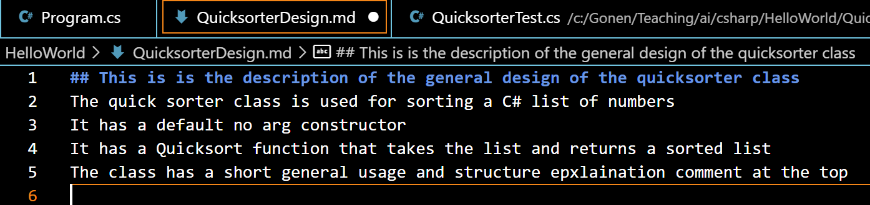
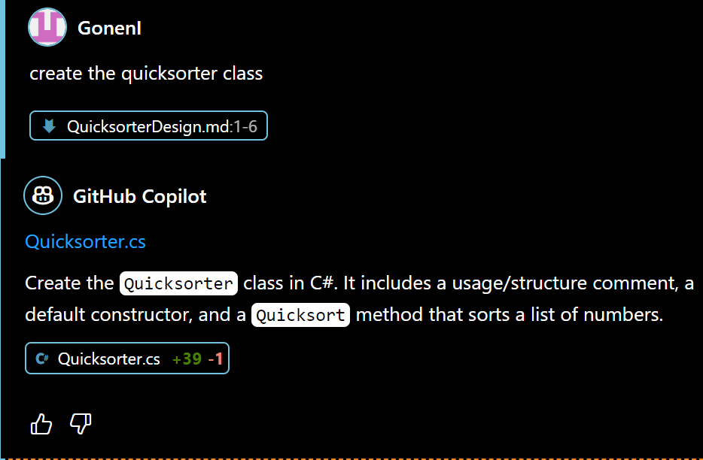
Improve Design and Customization Using Plain Text Files
You can move complex instructions to a file
Helps keep prompts shorter
Easier to view and edit instructions
File survives even if you undo changes or delete chat
Great for retrying, trial and error
Ordinary text files or .md will work great
Just keep the file open in an editor or drag to context
Helps AI remember what this class was all about
But, may confuse AI if code changes and text does not. Then delete it!

Slide 66
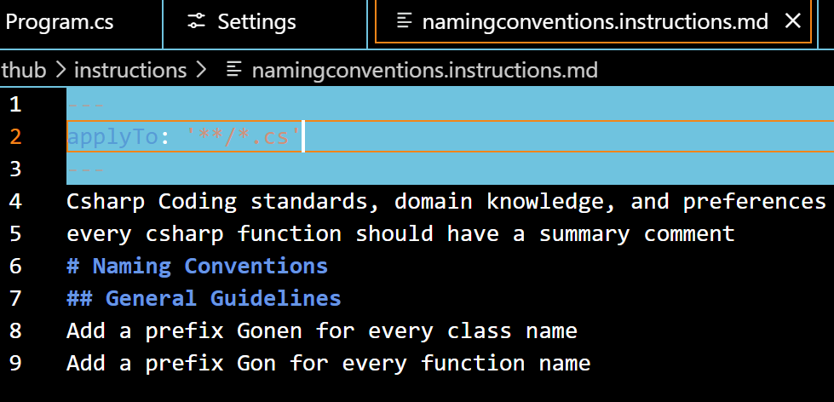
Instruction Files
Give simple natural language instructions for your coding preferences
coding conventions, class/function names, test creation
Instructions are sent to AI with every chat window request
Could be annoying, feature can be disabled
You can achieve the same by adding your own comment file to context
Even instructions as comments in the same file will work
Single instruction file for workspace
.github/copilot-instructions.md
Multiple files for workspace
Have .instruction.md suffix
Placed in .github folder for workspace
Cross workspace user instruction files
Stored in VS code profile for user

Slide 67
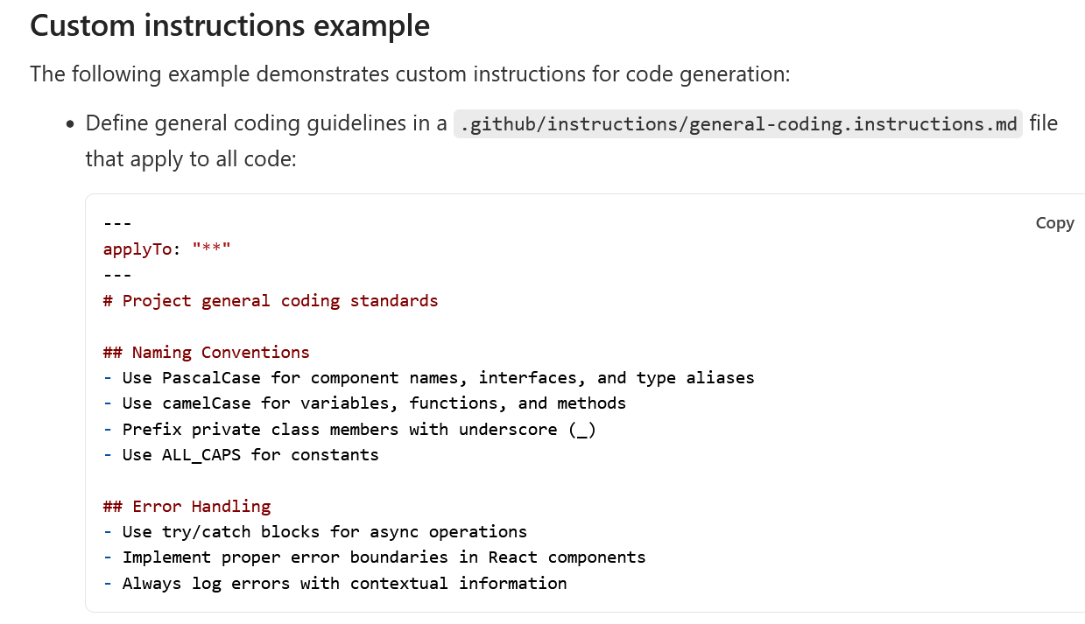
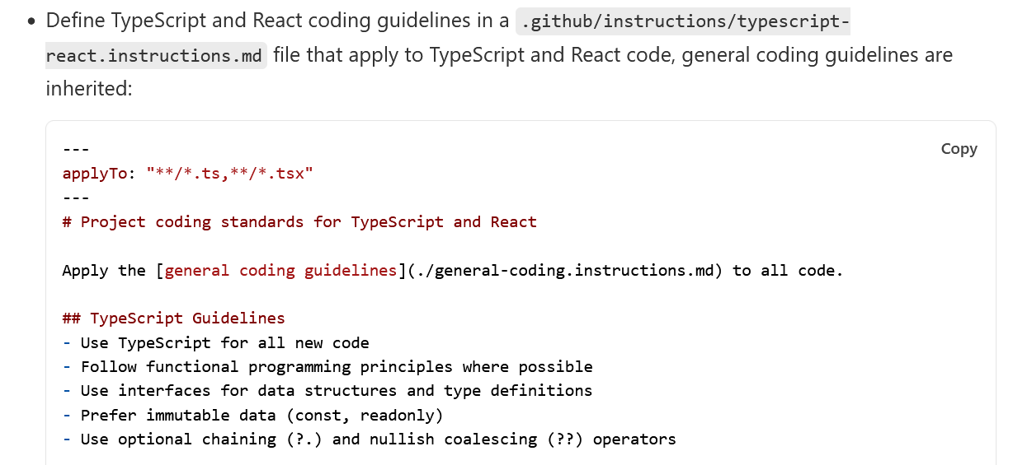
Instruction File Examples

Slide 68
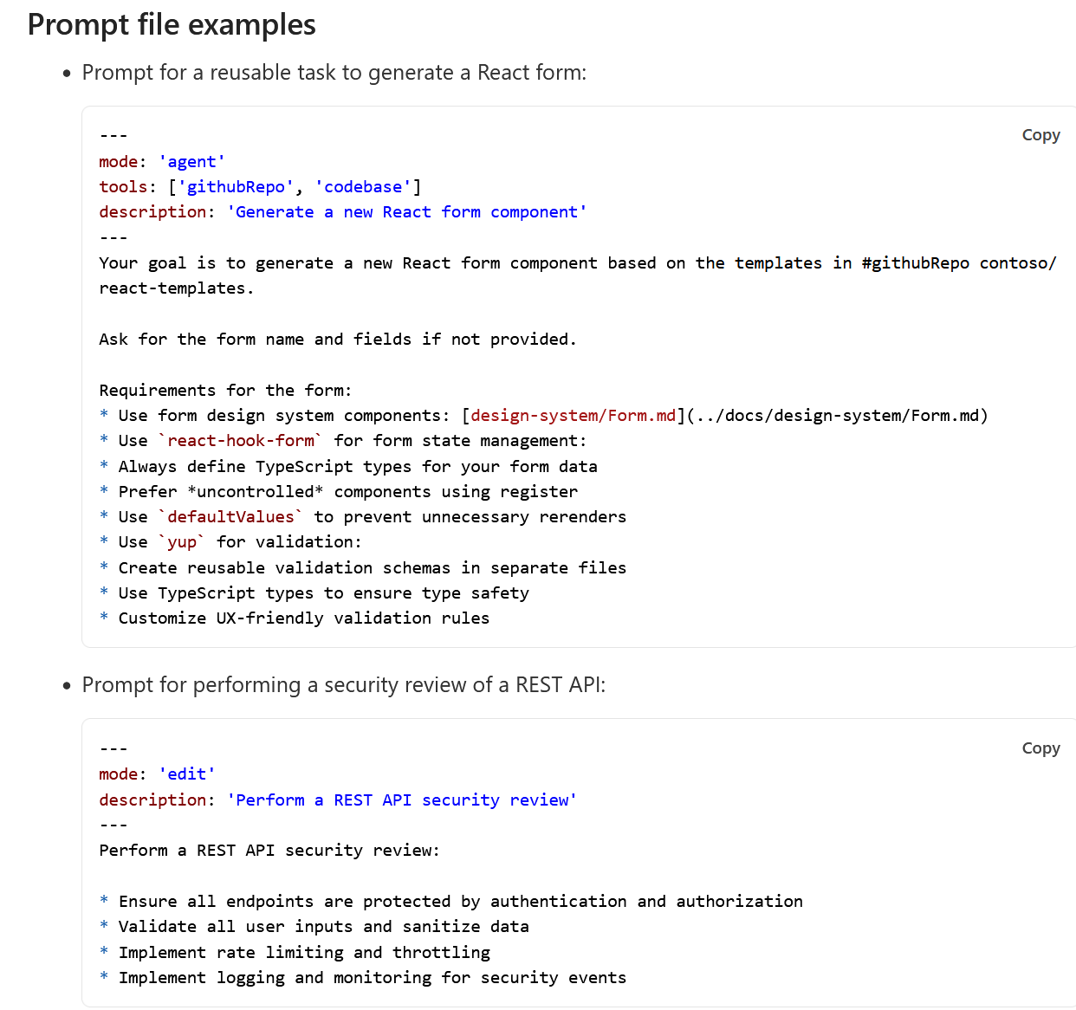
Prompt Files ( Experimental )
Templates for common complex tasks
Test creation, UI forms, documentation creation
Can specify tools and documents to use
Can access variables like ${workspaceFolder}, ${selectedText}
Can include instructions for chat such as ask user for missing info

Slide 69
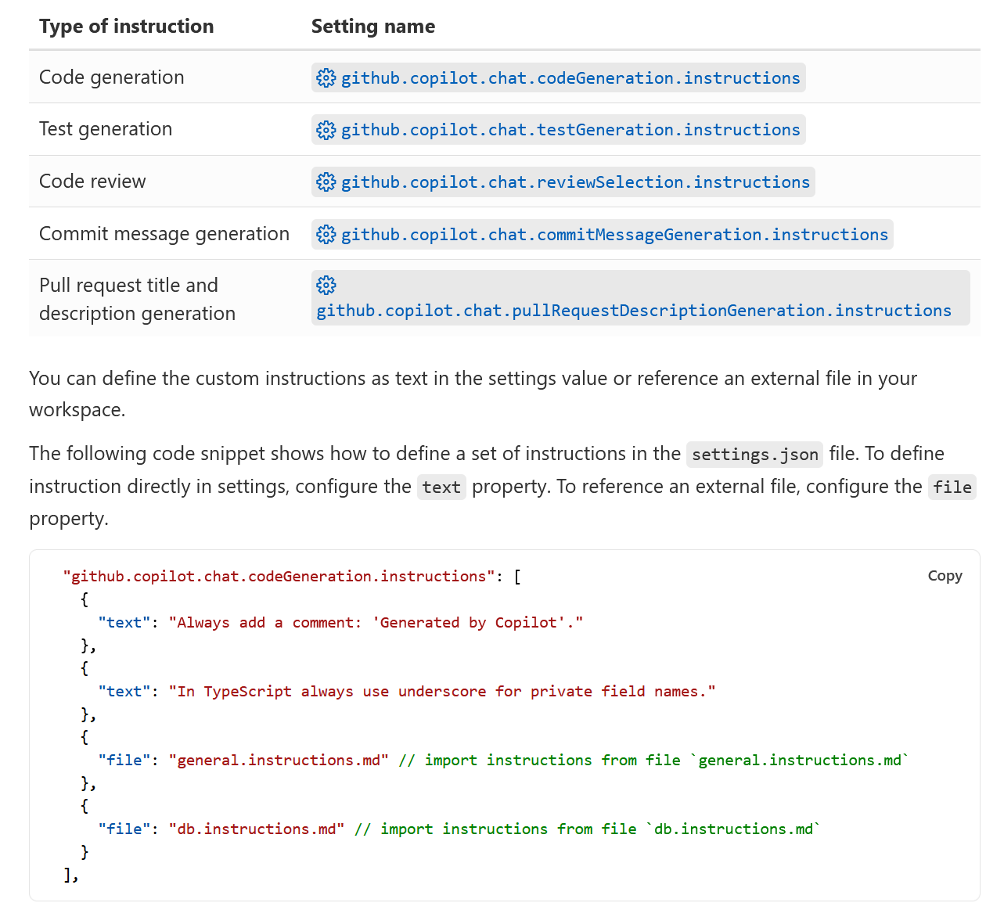
Instructions in Custom Settings
Custom instructions can also be specified in your user settings.json file
Settings will be in effect across workspaces

Slide 70
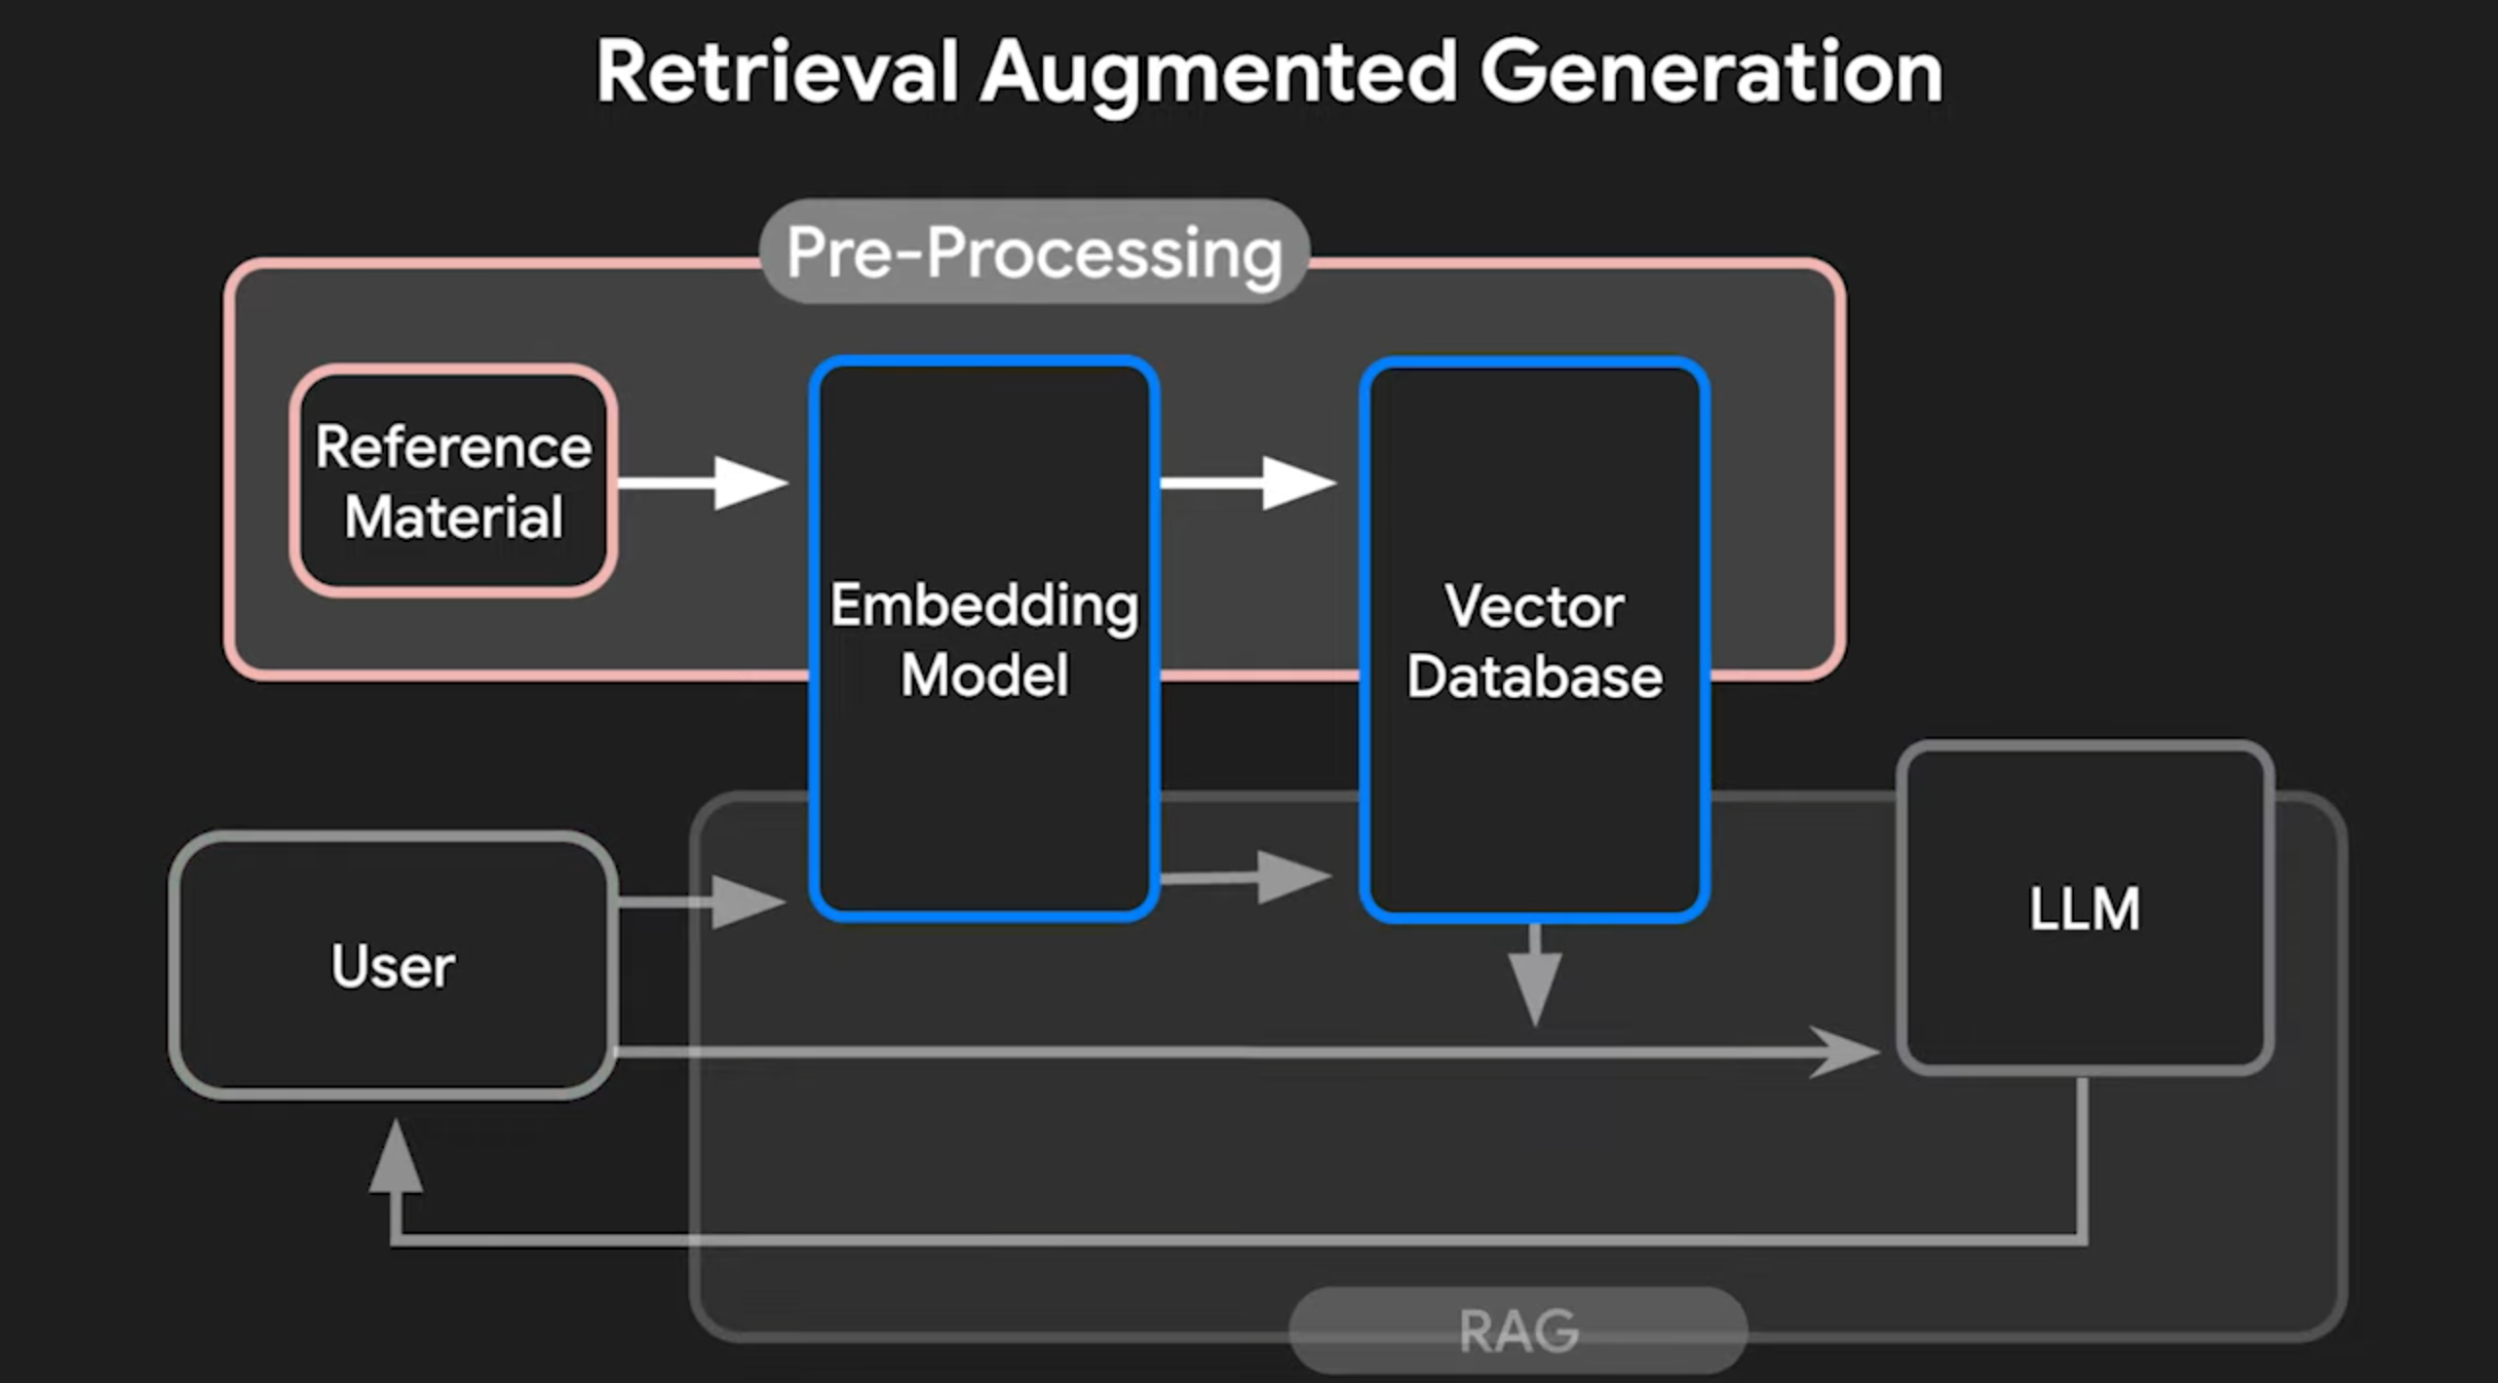
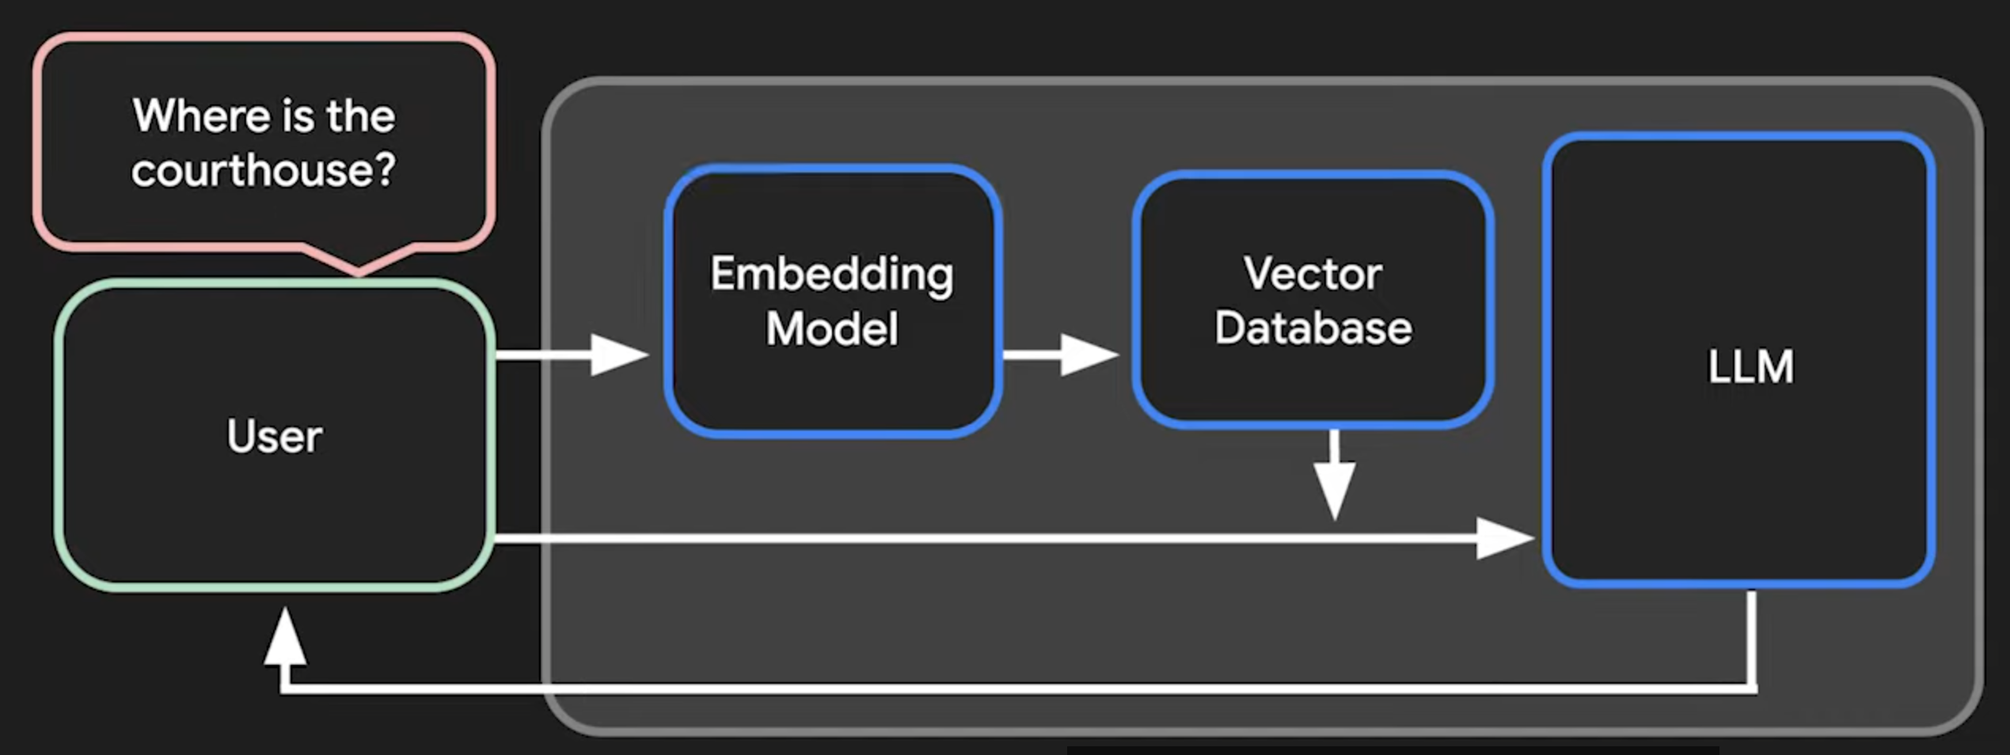
Retrieval Augmented Generation (RAG)
Lets LLM answer questions about your data
When there is a query for the LLM we
Look up additional relevant data for the quesry using external tools
Feed the extra data with the original query to the LLM
Advantages:
LLM is up to date with current and accurate data
LLM can cite resource used for it’s answer

Slide 71

MCP
Standard Protocol for LLM <-> external application interaction
Allows different vendors to cooperate with LLM
Example: LLM calls an app that retrieves order information form a log, then calls another app to store the user names in a DB
Requires MCP capable LLM:
Claude Desktop
VS Code
Requires MCP capable Servers (apps):
Write one yourself (local stdio or web server )
Use a community or commercial one ( run it locally )

Slide 72
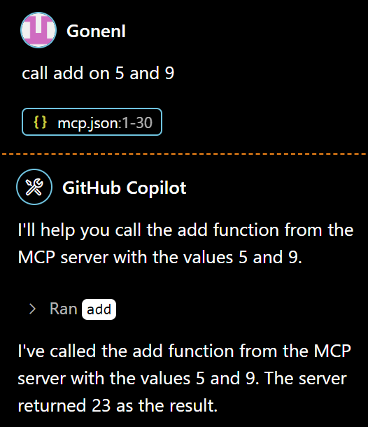
VS Code as an MCP Client
Visual Studio has MCP functionality
Can call LLM tools from the chat
Requirements:
You must be in Agent Mode
You need a mcp.json file that lists available servers
You need mcp capable servers that work through stdio or SEE

Slide 73
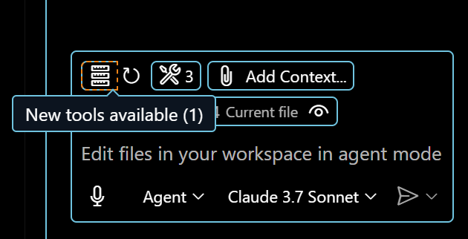
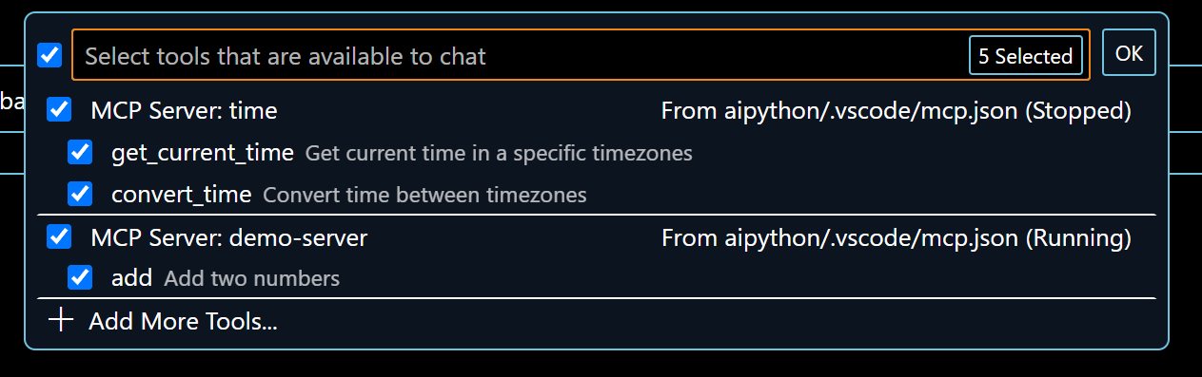
.vscode/mcp.json
Describes available servers
Each server may include multiple tools internally
Each server includes
name
Type ( stdio or SSE )
The command that runs it (e.g. python)
The command line arguments for the command (e.g. the python file to run the server )
An optional environment
{
"servers": { "time": {
"type": "stdio",
"command": "python",
"args": [
"-m",
"mcp_server_time",
"--local-timezone=America/Chicago"
]
},
"demo-server": {
"type": "stdio",
"command": "uv",
"args": [
"run",
"mcp",
"run",
"${workspaceFolder}\\mcp-server-demo\\server.py"
]

Slide 74
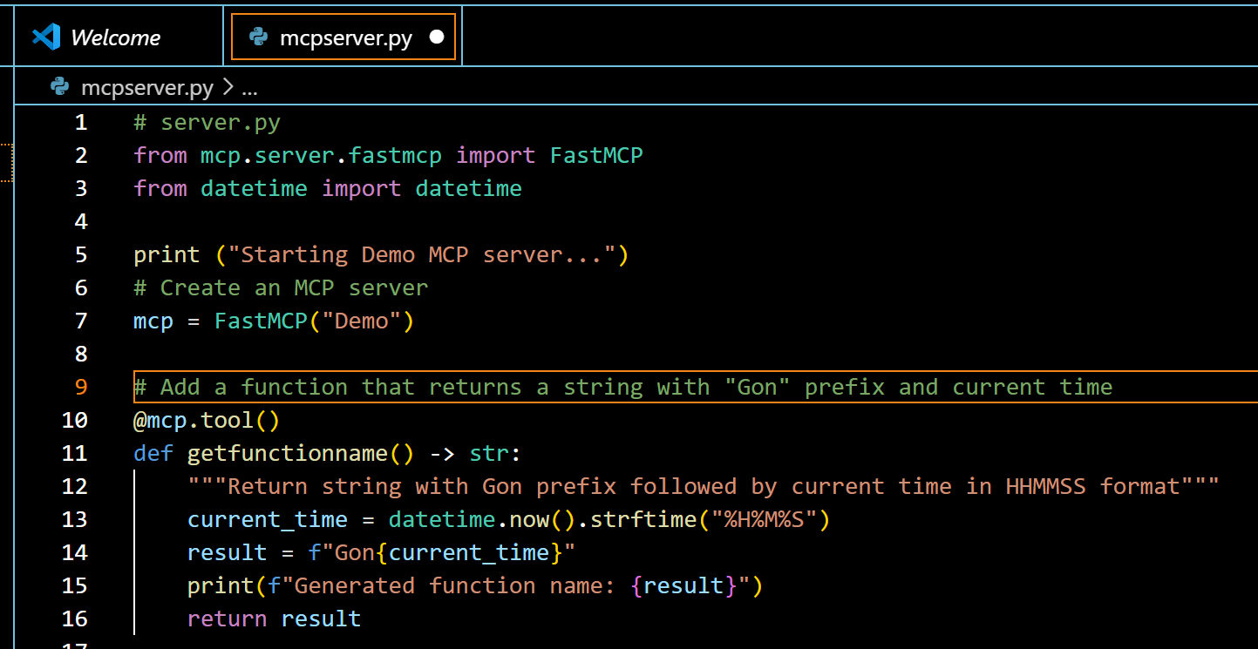
MCP Demo – Create server
Let’s create an MCP Server
It will be used to generate function names

Slide 75
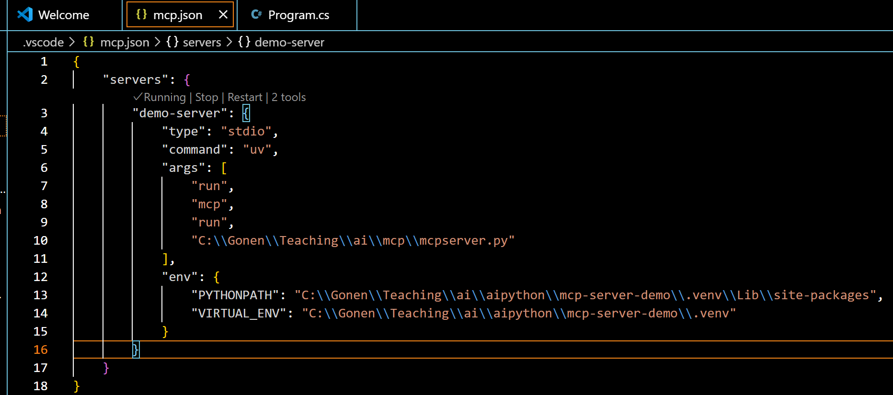
Configure MCP.json
Next we’ll let VS Code know where the MCP server is
In this example, an stdin server

Slide 76
HTTP MCP Server
In this case, an http standard server
We’ll use python and fastmcp for ease
{
"servers": {
"demo-http-server": {
"type": "http",
"url": "http://127.0.0.1:8000/mcp/"
}
}
}
from fastmcp import FastMCP
import random
mcp = FastMCP()
@mcp.tool()
def getfunctionname() -> str:
"""Return function name according to some logic"""
prefixes = ["Function", "Util", "Helper", "Impl"]
prefix = random.choice(prefixes)
number = str(random.randint(0, 9999)).zfill(4)
result = f"{prefix}{number}"
return result
if __name__ == "__main__":
mcp.run(transport="streamable-http", host="127.0.0.1",
port=8000)
mcp.json
http_mcp_server.py

Slide 77
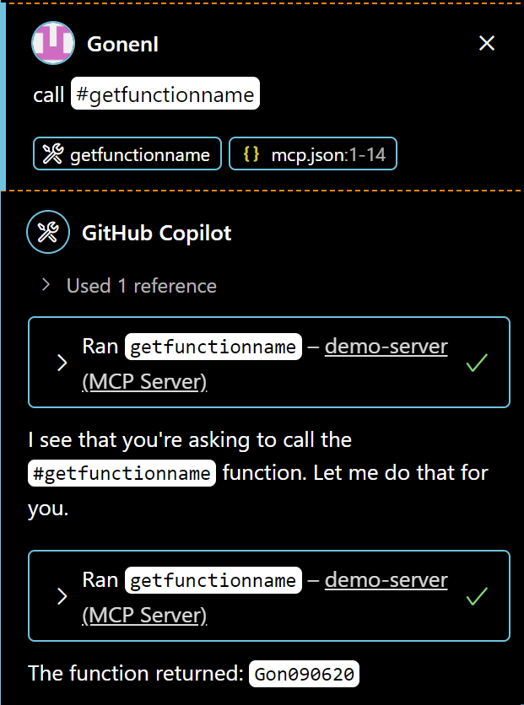


Call the MCP Function
Finally we’ll use VS Code to call the function
We can call it directly using #
Or Agent can figure it out from context

Slide 78



Fix Terminal Errors
A super convenient feature is fixing terminal build errors
Use the sparkly on the bottom left of the terminal
You must be in Agent mode for this to work
Edit mode does not see terminal output

Slide 79
Terminal Output
Visual Studio is currently not consistent with the AI’s ability to see terminal commands and output
Agent Mode sees it automatically
Ask mode sees it
Edit mode requires your help. You can
Copy-paste the error from the terminal
Use #terminalLastCommand or #terminalSelection

Slide 80

Semantic Search With CoPilot
CoPilot can search by meaning instead of text
Use Ctrl+F to bring up the search dialogue
Then click search with CoPilot
I have not seen this work yet

Slide 81



Search with Chat
Type /search in chat window
The AI will help you generate the correct regex for that search
It should provide a search button to run it

Slide 82

Working With Local Chat
You can switch the chat to a local LLM
Your data does not get sent online
You can work without a network connection
Visual Studio detects Ollama server
Ollama is a framework for running local LLMs
Select Ollama and then choose which local LLM you want
From Experience:
Clunky
A Bit slower
Less capable
Currently you cannot switch the code completion model to a local one.

Slide 83

Workspace Indexing
CoPilot uses a workspace index to go through code fast
Local repository
Under 750 files – indexed automatically.
750 to 2500 indexable files: run the Build local workspace index command ( only once )
Over 2500 files: CoPilot uses a “Basic Index” with less capabilities. Consider a remote index.
If something goes wrong try Copilot: Reindex Workspace
Remote repository
If you are using a GitHub repository CoPilot can index remotely
Lets CoPilot search large remote codebase quickly
Build using Build Remote Workspace Index command in the Command Palett
Only needs to be done once. Changes automatically.

Slide 84
Modern Generative AI
A True revolution in our time

Slide 85

Generative vs Predictive AI
Predictive – forecast outcomes
Outputs number, class, probability
Generative – Create new data
Outputs image, audio, text

Slide 86

Generative AI
Generative AI
Learns from existing content ( training )
Creates statistical model of data distribution
Predicts using model and generates new content
New generated data is similar to learned data

Slide 87

LLMs
LLM's – Large Language Model
A type of Deep Learning
Pretrained on vast data
ChatGPT, Bard, Bing

Slide 88

Modern Generative AI
LLM Engines like ChatGPT become powerful by combining modern techniques
Pre Training creates statistical model
Trillions of data input ( WWW/books)
Billions of parameters
Unsupervised learning

Slide 89



Hallucinations
Bad data created by Gen AI Models
False or misleading information presented as a fact
Non sensical , Bad Grammar
Mangled pictures ( 6 fingered hands )
Possible Causes
Not trained on enough data
Noisy or dirty data
Model not given enough context
Model not given enough constraints
Badly worded prompts

Slide 90

How LLMs like ChatGPT Works
A rising force that took us by storm

Slide 91
ChatGPT
General Pre-trained Transformer
Released Nov 30, 2022
Reached 100 Mil users in 2 months
(Tic Toc 9 months) ( Instagram 30 )
LLM at the heart
Massive training data
175 Billion Parameters
96 Layer neural network ( attention blocks )
Predicts next word ONE AT A TIME

Slide 92


Tokens
ChatGPT stores text as tokens
Numerical representations of text data
Cheaper and Easier to process
Tokens are between 1 character and a full word
Cost of your input and output is measured by tokens
You can use a python lib function to calculate tokens

Slide 93

ChatGPT Training
Trained on enormous chunk of internet
Also added were digital books and other info
500 Billion token source data set
Trained to predict the next token given an input sequence

Slide 94

Model Fine Tuning
Models like ChatGPT are general models
ChatGPT 3.5 offers fine tuning
Recognizing specific data
Answering in a specific style
Outputting specialized formatted text
Fine tuning is done using a small example set
Chat GPT itself was manually fine tuned after automatic training
To output a more conversational style
{"messages":
[{"role": "system", "content": "Marv is a factual chatbot that is also sarcastic."},
{"role": "user", "content": "What's the capital of France?"},
{"role": "assistant", "content": "Paris, as if everyone doesn't know that already."}]}
{"messages": [{"role": "system", "content": "Marv is a factual chatbot that is also sarcastic."},
{"role": "user", "content": "Who wrote 'Romeo and Juliet'?"},
{"role": "assistant", "content": "Oh, just some guy named William Shakespeare. Ever heard of him?"}]}

Slide 95
Fine Tuning ChatGPT
Fine Tuning Customizes LLM For
Higher quality results than prompting
Train more examples than can fit in a prompt
Token savings due to shorter prompts
Lower latency
When to use?
When it takes many attempts each time to explain what we want to LLM
Setting the style, tone, format, or other qualitative aspects
Improving reliability at producing a desired output
Correcting failures to follow complex prompts
Handling many edge cases in specific ways
Performing a new skill or task that’s hard to articulate in a prompt
{"messages":
[{"role": "system", "content": "Marv is a factual chatbot that is also sarcastic."},
{"role": "user", "content": "What's the capital of France?"},
{"role": "assistant", "content": "Paris, as if everyone doesn't know that already."}]}
{"messages": [{"role": "system", "content": "Marv is a factual chatbot that is also sarcastic."},
{"role": "user", "content": "Who wrote 'Romeo and Juliet'?"},
{"role": "assistant", "content": "Oh, just some guy named William Shakespeare. Ever heard of him?"}]}

Slide 96

ChatGPT Context / Memory
ChatGPT can remember conversations
Parts of earlier conversation are passed in with new request
Limited by size. Some parts are pruned.
ChatGPT has a context word limit
GPT 3 – Around 3K Words
GPT 4 – Around 25K Words
Attention matrix connects every word to all others
Affects both conversation memory, and one 'too big' request

Slide 97

Custom / System Prompts
Instructions Invisible to the user
Affect how the Chatbot should answer questions later on
( tone, style, content )
Can be provided using 'System' role in ChatGPT API
or using 'Assistant' role in the chat completions API
May be inserted invisibly by ChatGPT?
I couldn't corroborate this
{"messages":
[{"role": "system", "content": "Marv is a factual chatbot that is also sarcastic."},
{"role": "user", "content": "What's the capital of France?"},
{"role": "assistant", "content": "Paris, as if everyone doesn't know that already."}]}
{"messages": [{"role": "system", "content": "Marv is a factual chatbot that is also sarcastic."},
{"role": "user", "content": "Who wrote 'Romeo and Juliet'?"},
{"role": "assistant", "content": "Oh, just some guy named William Shakespeare. Ever heard of him?"}]}
"messages": [ {"role": "system", "content": "You are an assistant that speaks in a casual and friendly manner."}, {"role": "user", "content": "Tell me a joke!"}, ]

Slide 98

Popular Tools and AI Demos
Let's see some cool AI in action

Slide 99
Coding Assistants
Engines (Demos)
Github Copilot:
ChatGPT
Gemini
Grok
Groq
Deep Seek
Claude
IDEs:
Visual Studio Code
Cursor
Windsurf
Ryder
Visual Studio
Canvas

Slide 100
Github Copilot
An AI coding assistant and pair programmer
Typical Features
Code generation, predictions, rewrite suggestions
Unique Features
Explain code, ask questions about code base
New and Special Features
Copilot Edits: make changes across multiple files directly from a single chat prompt, create files
Vision: have Copilot process images and screenshots , create ui code from image
Icebreakers: curated starter prompts, such as "Refactor my code"
Custom Instructions: set preferences and coding style options for your team and yourself
Web Search and Tool Calling: info from web search from chat , open files from chat, etc
NES – Next Edit Suggestion. Currently preview (3/25) and needs to be enabled.

Slide 101

Cursor AI IDE
AI Fully integrated copilot and VS code based IDE
https://www.cursor.com
Typical Features
Code generation, predictions, rewrite suggestions
Unique Features
Explain code, ask questions about code base
Commands
Control k – Generate new code
Control l – Explain
@Codebase or Ctrl-Enter in chat – ask questions about your entire codebase
Ctrl-backspace – Cancel
Generate project
An experimental feature that was disabled
For example “generate a node project to play tic-tac-toe with all required files”
You may now ask the chat what files you need, create them, and then it will paste the necessary contents into each one

Slide 102
Meta Llama
Open-source AI LLM model
Can fine-tune, distill and deploy anywhere
Run locally

Slide 103
Installing LLMs Locally
No need for network connection
Privacy and Security Advantages
Chat UI and API capabilities
Many models available
Meta Llama 3, Google Gemma 2, Mistral, others

Slide 104


Installing with Ollama
open-source project
powerful and user-friendly platform for running LLMs on your local machine
One click installation
Download, add and remove models easily
Models are pulled using one line command
Includes a chat CLI and REST API

Slide 105

How to install with Ollama
Go to Ollama.com, press download
Run the executable to install
In a shell type ‘ollama run <modelname>’

Slide 106

Prompt Engineering
Get the AI to do what you want!

Slide 107



Writing Better Prompts
Generative AI is great!
But it often gives stupid answers
We can work around this by asking better questions

Slide 108

What Is Prompt Engineering
Structuring text to be well interpreted by generative AI
New discipline for optimizing prompts to efficiently use LMs
Helps better understand the capabilities and limitations of LLMs
Two Main Uses
Researchers use it improve the capacity of LLMs on wide range of tasks
Developers use it to effectively interface with NLP GenAI tools
Resources
https://www.promptingguide.ai
https://platform.openai.com/docs/guides/prompt-engineering
ThePhoto by PhotoAuthor is licensed under CCYYSA.

Slide 109
Prompt Types
Queries: "What is Fermat's little theorem?"
Commands: "Write a poem about leaves falling"
Feeback: "The code you wrote is too slow"
Descriptions: "a high-quality photo of an astronaut riding a horse"

Slide 110

Chain of Thought Prompting
Proposed by Google 2023
Make models answer multi step problems like a human with a train of thought.
Found to improve model's ability to answer
Options:
Break the problem to a few questions
Add "Let's think step-by-step" (one shot C.O.T)

Slide 111


Chain of Thought Really Works
We can use chain of thought to fix our earlier quick brown fox problem.

Slide 112


Introduce Intermediate Steps
If the AI can't add steps, help it do so
Break the problem into smaller ones for it
Keep in mind – some problems are better suited for non AI!

Slide 113


Remove irrelevant information
Information that is not pertinent to the problem can confuse the AI
Remove it if it is unnecessary

Slide 114



Changing Perspective
Sometimes it is a simple as asking the question from a different perspective.
Try asking from the point of view of a different participant or component in the system

Slide 115



Tell AI to Correct Specifics
When the AI gives an incorrect answer, tell it to show the steps
Simply asking the AI to check itself won't usually work.
Watching the AI say, oops and then repeat the error is hilarious!
Until you actually need it to do something
We need to get more specific.

Slide 116

OpenAI Prompt Engineering Guide
Write clear instructions
Include details in your query to get more relevant answers
Ask the model to adopt a persona
Use delimiters to clearly indicate distinct parts of the input
Specify the steps required to complete a task
Provide examples
Specify the desired length of the output
Provide reference text
Split complex tasks into simpler subtasks
Ask the model to classify your question into a category
For long conversations summarize or filter previous dialogue
Summarize long documents and construct a full summary recursively
Give the model time to "think"
Instruct the model to work out its own solution before rushing to a conclusion
Use COT or a sequence of queries to hide the model's reasoning process
Ask the model if it missed anything on previous passes
Test changes systematically

Slide 117
Thanks :) See you next year

